Slide 1

Wellness Weekend 2015….Welcome & Intros:
Notes:
Wipe transitions with pictures and captions
(Basic)
To reproduce the picture effects on this slide, do the following:
On the Home tab, in the Slides group, click Layout, and then click Blank.
On the Insert tab, in the Images group, click Picture. In the Insert Picture dialog box, select a picture and then click Insert.
Select the picture. Under Picture Tools, on the Format tab, in the Size group, click the Size and Position dialog box launcher. In the Format Picture dialog box, resize or crop the image so that the height is set to 4” and the width is set to 10”. To crop the picture, click Crop in the left pane, and in the right pane, under Crop position, enter values into the Height, Width, Left, and Top boxes. To resize the picture, click Size in the left pane, and in the right pane, under Size and rotate, enter values into the Height and Width boxes.
Also in the Format Picture dialog box, click Shadow in the left pane, in the Shadow pane, click the button next to Presets, and then under Inner click Inside Top.
Also in the Format Picture dialog box, click Glow and Soft Edges in the left pane, in the Glow and Soft Edges pane, under Glow, do the following:
Click the button next to Color, click More Colors, and then in the Colors dialog box, on the Custom tab, enter values for Red: 157, Green: 177, and Blue: 91.
In the Size box, enter 8 pt.
In the Transparency box, enter 60%.
To reproduce the text effects on this slide, do the following:
On the Insert tab, in the Text group, click Text Box, and then on the slide drag to draw your text box.
Enter text in the text box, and then select the text. On the Home tab, in the Font group, do the following:
In the Font list, select Calibri.
In the Font Size list, select 24 pt.
Click the Font Color, and then under Theme Colors click White, Background 1 (first row).
Click Italic.
Position the text box below the picture.
To reproduce the transition effects on this slide, do the following:
On the Transitions tab, in the Transition to This Slide group, click More, and then click Wipe.
Also on the Transitions tab, in the Transition to This Slide, click Effect Options, and then click From Right.
Also on the Transitions tab, in the Timing group, do the following:
In the Duration box, enter 2.00 seconds.
Clear the On Mouse Click box.
Select After, and then in the After box enter 3.00 seconds.
To reproduce the second, third, and fourth slides, do the following:
In the Slides pane, select the slide. On the Home tab, in the Slides group, click the arrow below New Slide, and then click Duplicate Selected Slides. Repeat this process until there are three slides.
On the slide, select the picture. Under Picture Tools, on the Format tab, in the Adjust group, click Change Picture. In the Insert Picture dialog box, select a picture and then click Insert.
In the Slides pane, select the third slide.
On the slide, select the picture. Under Picture Tools, on the Format tab, in the Adjust group, click Change Picture. In the Insert Picture dialog box, select a picture and then click Insert.
To reproduce the background on this slide, do the following:
On the Design tab, in the Background group, click Background Styles, and then click Style 12 (third row).
(Note: Selecting this background changes the colors on the slide.)

Slide 2
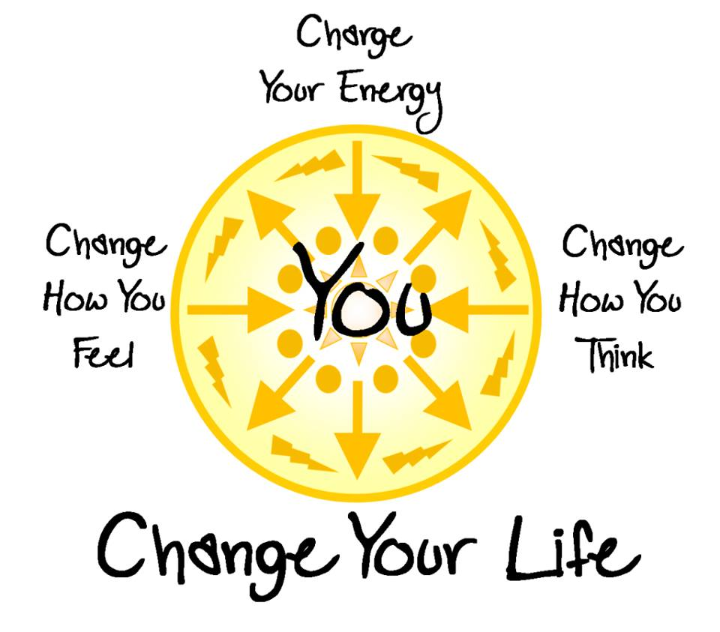
WELLNESS
Is finding a balance
between
Body
Mind
Spirit….
Creating that
Balance is
Change that can help improve you!
Our Schedule this weekend tries to provide workshops in all 3 areas of Body, Mind & Spirit:

Slide 3

Wellness Weekend Schedule:
Friday 3-20
7 pm Welcome/Intros, God Dilemma & Thoughts on Spirituality (David) *set massage apts
8 pm Usui Reiki Class (David) Love Offering
9:30 pm AA fireside sharing meeting
Saturday 3-21
10 am Intro to Massage & Bodywork 5 opportunities: *Chair 10-20min, Massage 30-60min, or Body Work 60min all at $1 per min/set apt for individual sessions
11 am Therapeutic Yoga for Individuals and Couples (Tzivia) Bring pillows & blanket to class
suggested donation $15 per person/$20 couple
1 pm Intro to Meditation (Bro ChiSing) Love Offering
5 pm Healthy Living Diet No More (David)
Love Offering
7 pm Healthy Eating Potluck Dinner & Social
8 pm Movie “The Power of the Heart”
9:30 pm AA fireside sharing meeting
Sunday 3-22
9 am Usui Reiki part two class (David)
Love Offering
11 am Group Meditation/noon departure

Slide 4
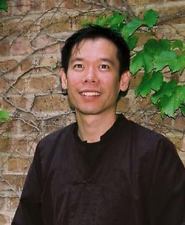
OUR GUEST PRESENTORS:
Bro ChiSing
From the Dallas Meditation Center presenting:
“Practical Meditation
For Busy People”
Sat 1 pm

Slide 5
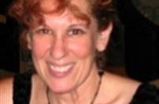
Tzivia
From the Healing Circle Center presenting:
“Therapeutic Yoga Class”
Sat 11 am
(Bring your pillow & blanket to class)

Slide 6
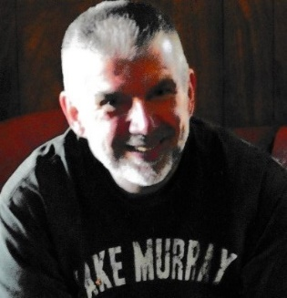
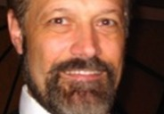
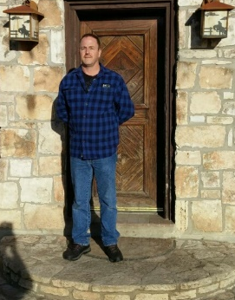
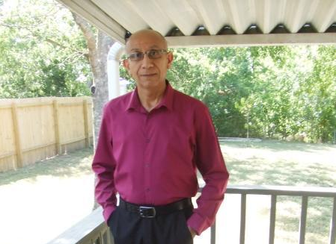
Intro to Massage & Body Work Sat 10 am:
(set individual Apts during Weekend $1 per min)
David
Chair Massage
10 & 20 min Pavillion
Claude & Tzivia
Massage
30 & 60 min
Garage Apt by Ranch House
Bo & Shawn
Body Work
60 min only
Campsite #33 by Pool

Slide 7
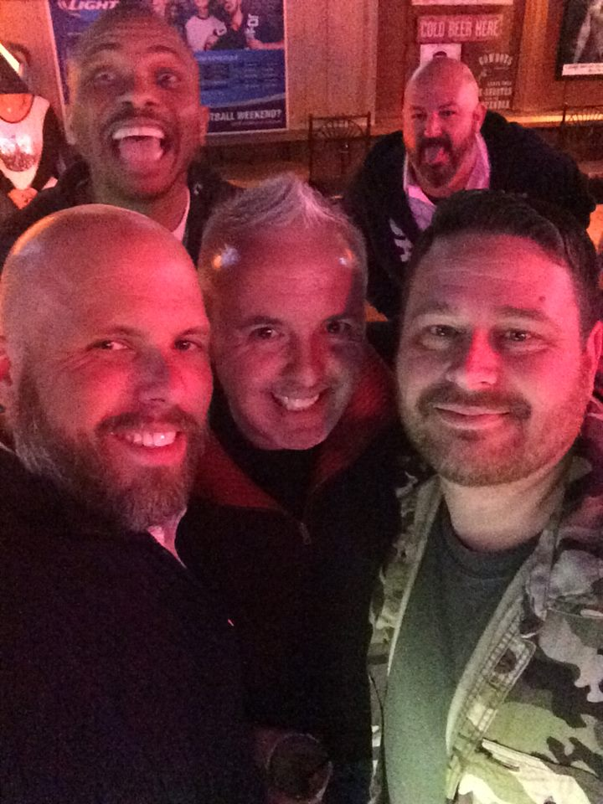
Need any Help from
The Ranch see
Bradley
Rainbow Ranch
Coordinator

Slide 8
CHANGE is constantly happening….
The only thing
You have control
Over is how
You REACT
To change…
Will you be buried
Under it?….or
Use it as fertilizer
For new growth!

Slide 9
BE EMPOWERED
This Weekend
To make
POSITIVE
CHOICES FOR CHANGE
for
Yourself! ☺
FIND BALANCE IN
YOUR BODY, MIND & SPIRIT

Slide 10
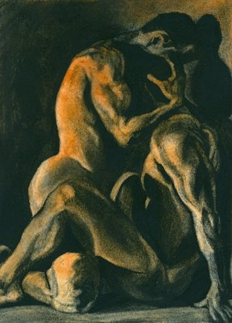
GOD Dilemma:
An Intimate
Conversation
Between 3 Characters…..
Painting by
Mark Villalpando

