Slide 1

Finding your Authentic Self
Composed by David Benzshawel

Slide 2
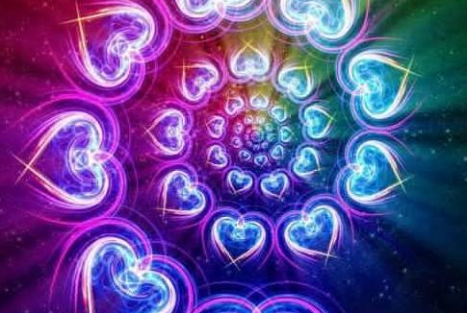
I am here to share with you my adventure this year 2024...
In January with my FaceBook Groups I began sharing a daily reflection on a meme that resonated with me....in the style of self reflecitng journaling I only spoke from my own personal experience & did not quote other authors or pass on advice. I called this experience my journey to find my authentic self.
I am now retired from working with at&t for 29 yrs and serving others as an old catholic priest for 42 yrs. In the branch of the old catholic church where I was ordained the priest was self supporting working a secular job rather than depending on the home church for support. I did pastor full time 3 UFMCCs but found that it eventually burnt me out. I rather work in small groups or online now. I got a licentiate degree from the Anglican School of Theology in Spiritual Direction/Spiritual Theolog in 1998. I enjoy helping others find their spiritual path to Source and also have a website reikiaccess.com for over 25 yrs.

Slide 3
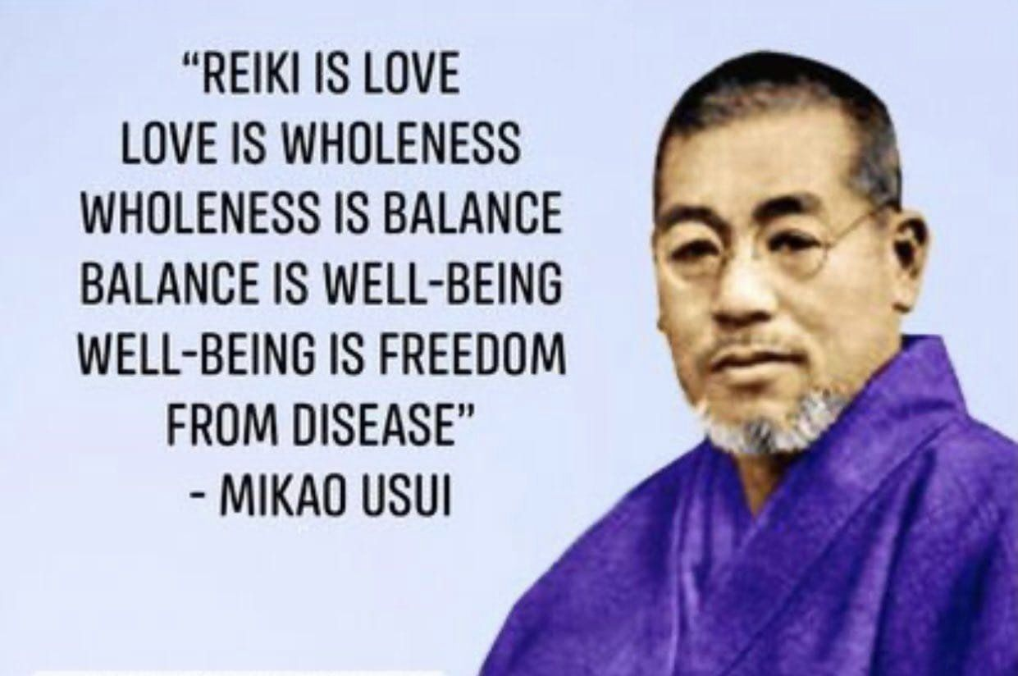
Even though I was raised Roman Catholic, since highschool I have always been interested in other spiritual paths & was involved with the Jesus People & the Charimatic Renewal ...so over time i began to be more ecumenical....when I learned Usui Reiki I had a spiiritual awakening learning abt energy & chakras in my body. I was so intrigued by reiki/energy work that I went out & learned 130 different forms of reiki/energy work....i set up my websire reikiaccess.com to introduce others to reiki and on the homepage if you click on the link "Where to Begin" you can learn online the first level of Usui Reiki for FREE
From Reiki I became more interfaith & a buddhist....i now help others create their own form of reiki/energy work that most resonates with their unique spiritual path

Slide 4
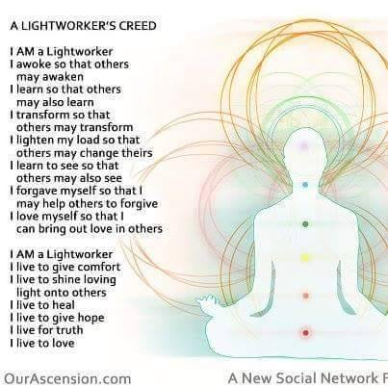
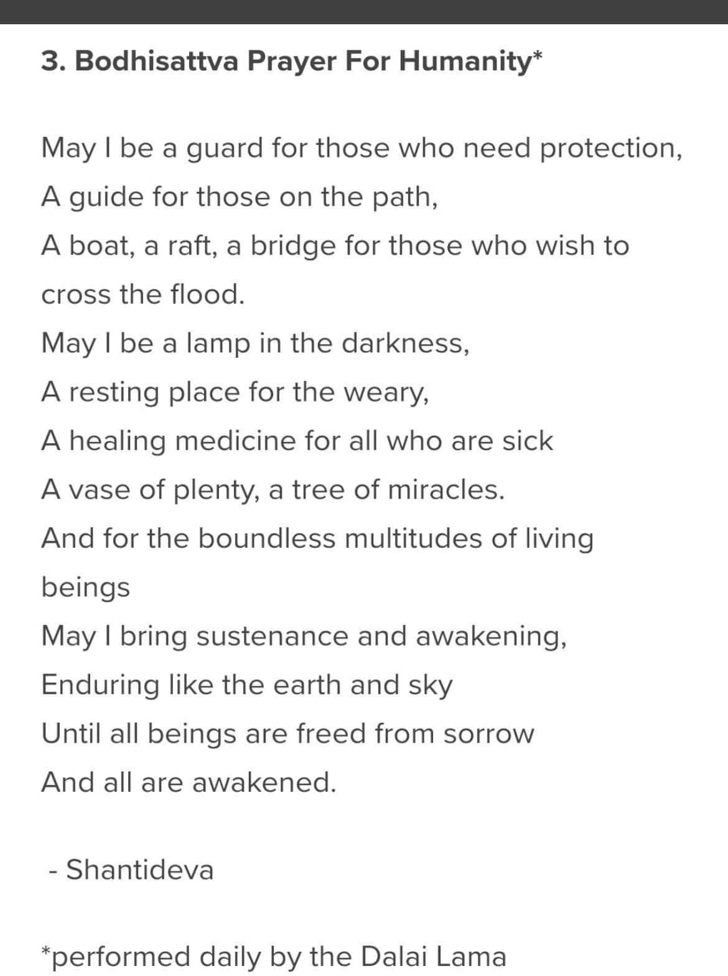
Through buddhism I learned abt the Bodkhisativa vow & through energy work found the Lightworkers Creed....both very foundational for me in descibing my purpose here on earth. Ram Dass says "we are here to help walk each other home". So my calling is to help others they can still be spiritual even though they may have been hurt or rejected by Religion which is a human institution that strive to form community by enforcing dogma & doctrine necessary to be part of the community. Spirituality for me is my own unique spiritual path & direction connection to Source

Slide 5
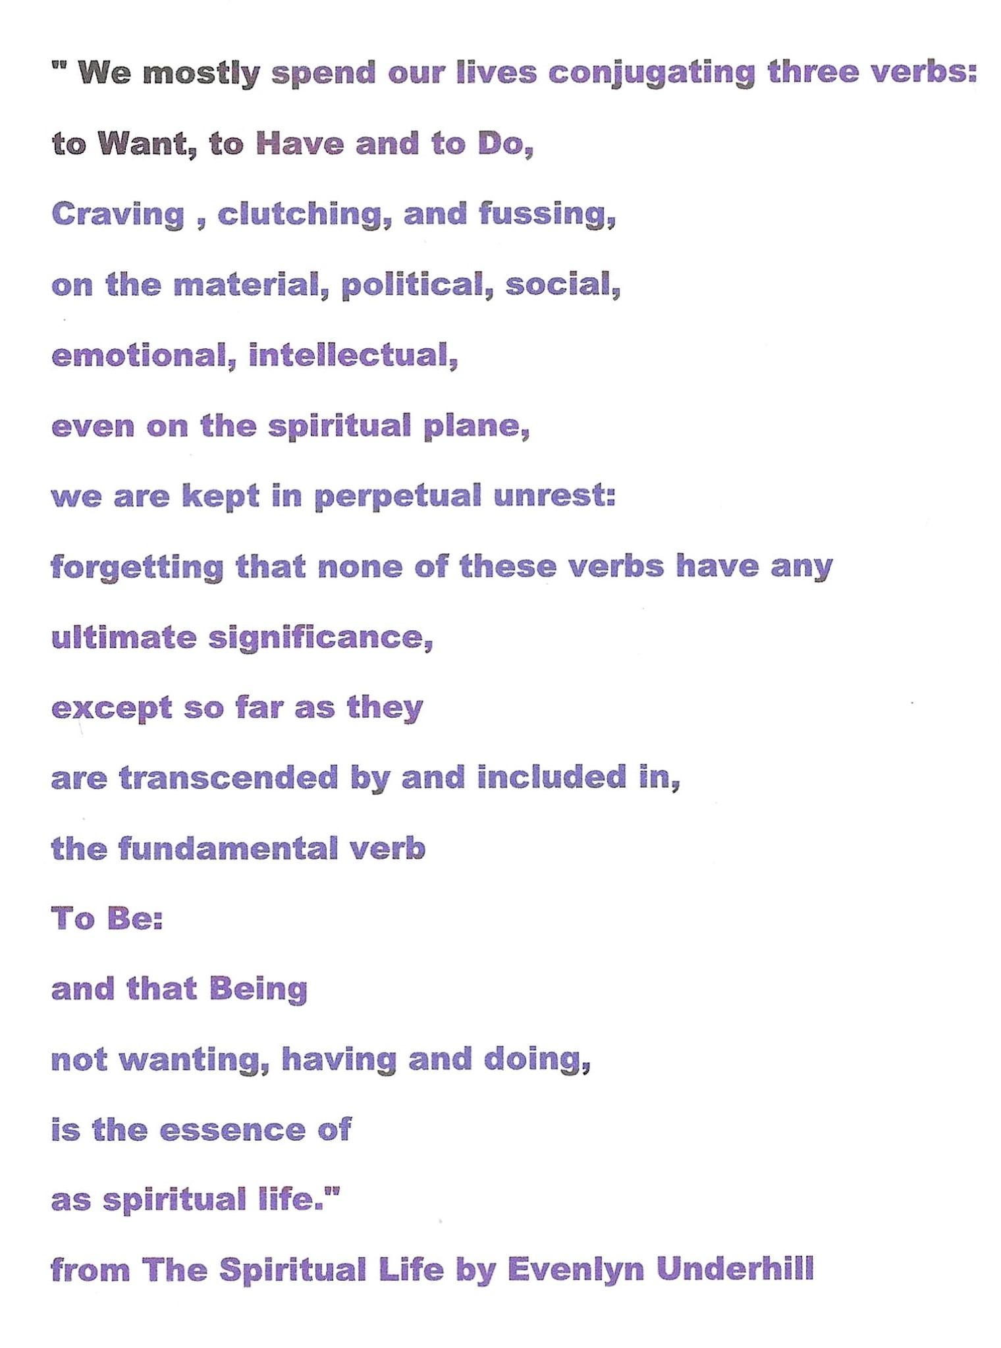
My journey to my authentic self actually started when I began to focus more on BEING rather than DOING....for me BEING is my spiritual focus of the SOUL whereas DOING is paying the bills to survive and is more the focus of the EGO

Slide 6
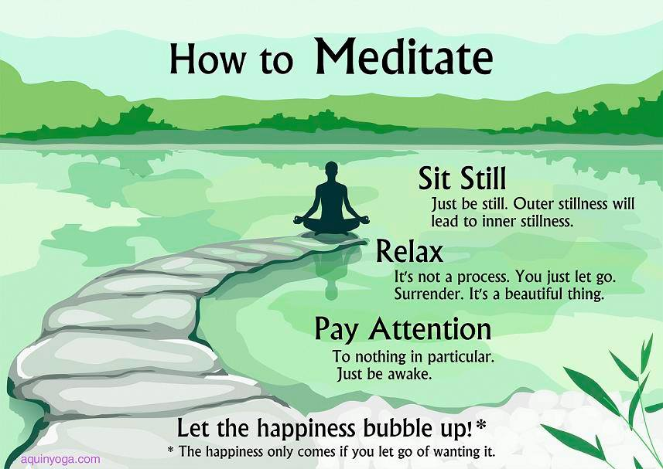
The second stage for myself was to learn to meditate to calm & train the Monkey Mind that wants to jump from thought to thought....on Netflix is a helpful series called "Guide to Meditation" if meditation is new for you....

Slide 7
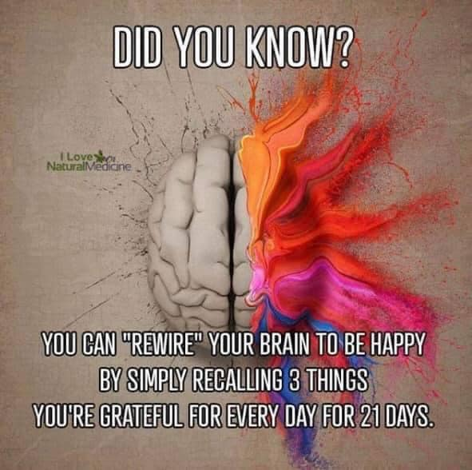
I found once I had calm my mind down , I needed to begin the work or re-wiring my brain. The EGO does not want change so it recycles past regrets & negative self talk. Thankfully the mind is fluie & is capable with a little work to replace old patterns with new ones. Louise Haye has allot of positive affirmations that I use as well as when a old negative thought/regret comes up I immediately try to refrome it into something more positive. Now when the old thought comes up I say that is no longer my reality & say the new more positive thought.....eventually the old thought is totally replaced with the more positive one

Slide 8
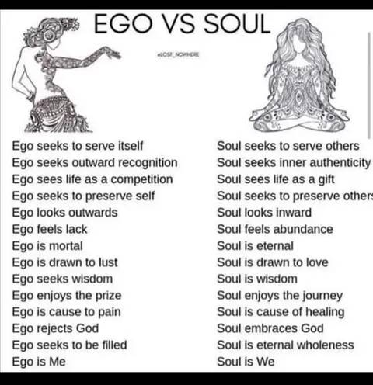
Once I had a more positive outlook I began to look at how the EGO/couscious mind & the SOUL/subconscious mind affecting my outlook. The EGO does NOT want change, growth or to evolve...it likes things as they are. It functions mainly when we are awake & involved in the world. It recycles negative self talk & regrets from the past.
The SOUL wants to change, evolve & grow to the ever increasing horizon. The SOUL is on 24 hrs a day & uses dreams to try to communicate with the EGO in trying to work out events that may have happened during waking time or try to inspire a new direction.
I found for me I had to replace a dualiistic approach of black/white, either/ore ….life is NOT that way of always being in conflict/VS but more of a balance of both/and, win/win.

Slide 9
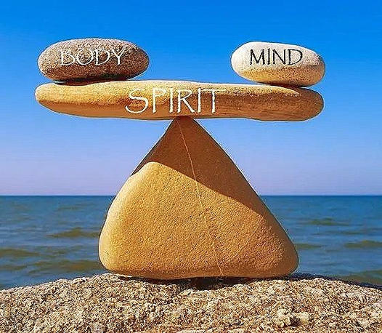
So ideally the approach I now use is trying to find a balance between Body, Mind/Ego & Spirit/Soul. For me I lap swim 6 days a week, spend more time outside, walks on the beach, bird watching....being more active & eating a Vegan Diet now for 8 yrs.
25 yrs ago I weighed 300 lbs vefore my dad died from Parkinson Disease & my mom was very overweight. I knew I did not want to repeat family history of disease & taking medication so I had a gastric sleeve surgery done & lost over 100 lbs.
By dractically changing my eating to a more healthy lifetsyle to becoming a vegetarian & eventually a vegan I was able NOT to gain the weight back & decrease all my medications I was on.

Slide 10
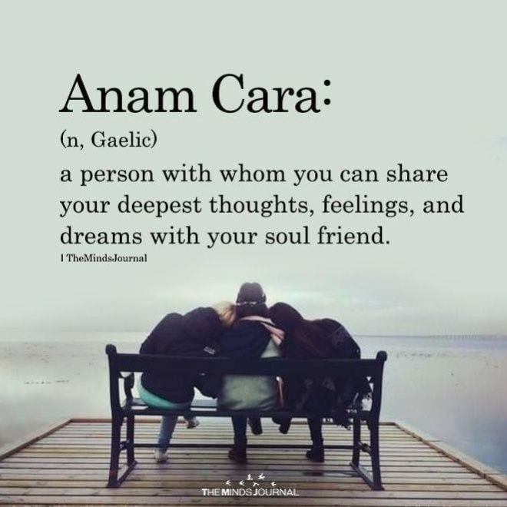
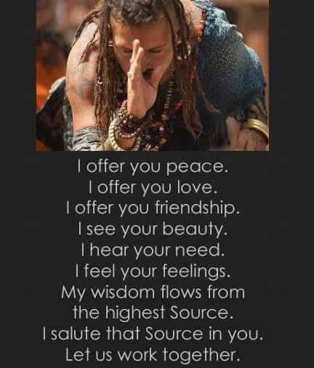
I found that having some kind of community connection helps me feel supported & encouraged to grow more. I found for me that FaceBook with over 5K friends has met that need for me as well as my website reikiaccess.com which has been up & added to for over 25 yrs. I describe my current spiritual path as being a pagan zen buddhist....i was never a real community kind of person but a loner who finds kindred souls for the support I need....

Slide 11
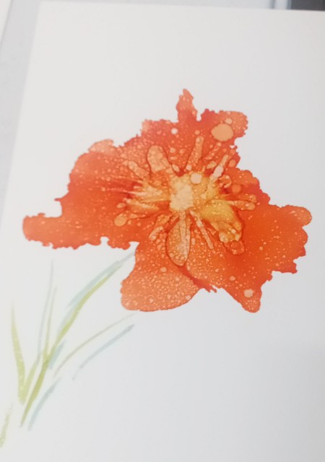
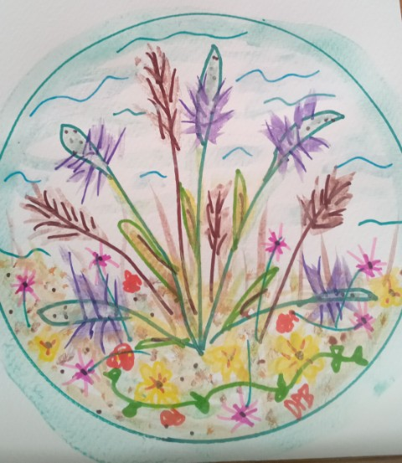
Since I retired on to the Island, I have taken a couple of art classes with local artist here at The Art Center....these are some of my paintings I did 3 yrs ago now....i have also taken up making beach bracelets from shells I find on the beach & beach art from driftwood & stones/shells I have found here also. Creativity is a imporant part of feeding my SOUL & enriching my spirituality as well as random acts of kindess of giving them away to visitors & residents on the Island We have 1300 acres preserve here for bird watching, wild flowers & much wild life on the island.

Slide 12
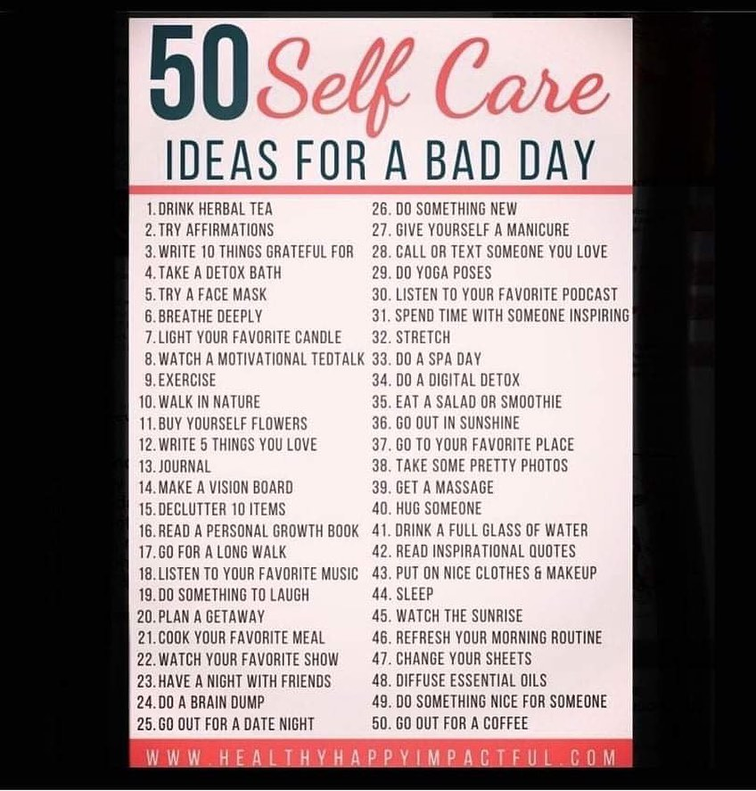
Foundational to finding my authentic self was to begin to learn about codependency, self care, self talk & self love....not to be selfish but my learning more about my authentic self I feel I can better BE my best person for others to meet & enjoy. I do like to read & study but in matters of the heart/soul it seems I have learned best from the "school of hard knocks" or as my dad use to say "you just need to learn to roll with the punchs" or "Sh*t happens are you going to let in bury you under or use it for fertilizer for new growth".

Slide 13
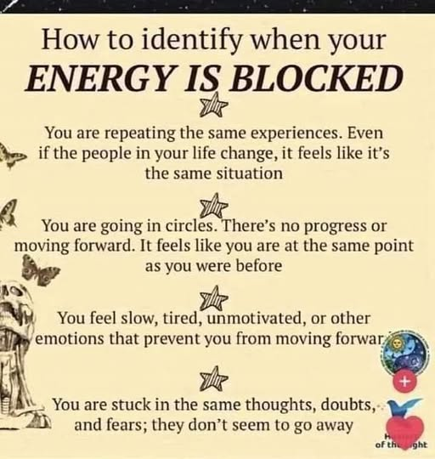
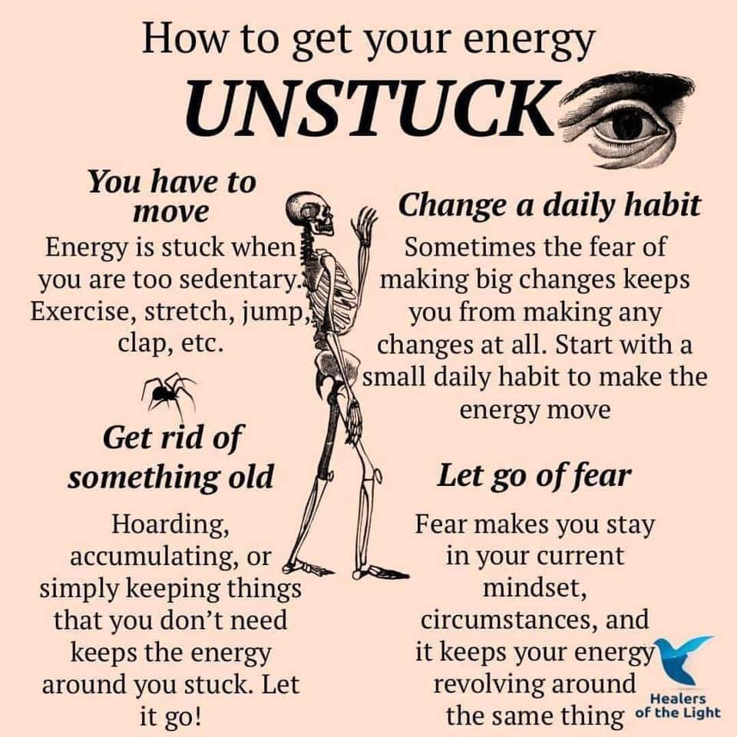
So you may find a time when you feel blocked & want to get your energy unstuck....here are some suggestions....like everything on this presentation these are only suggestions....find one that resonates with you & try it out for awhile...only you know if it is working & helps your energy flow again. Learning reiki has been a great help for me in understanding energy flow, where in my chakras I maybe blocked & how to remove the blockages.

Slide 14
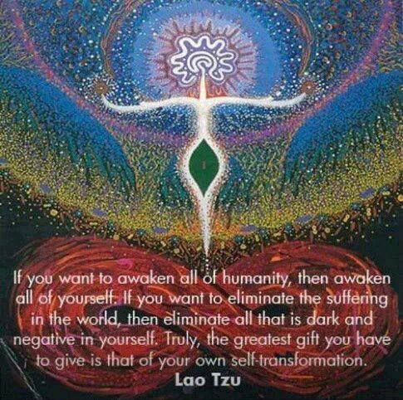
I believe self care & love in finding your authentic self will benefits ALL since we are all interconnected....a simple pebble falling into the ocean creates a ripple then a wave that will eventually reaches around the world.
BE the CHANGE you want to see in the world.......
love begins with you first

Slide 15
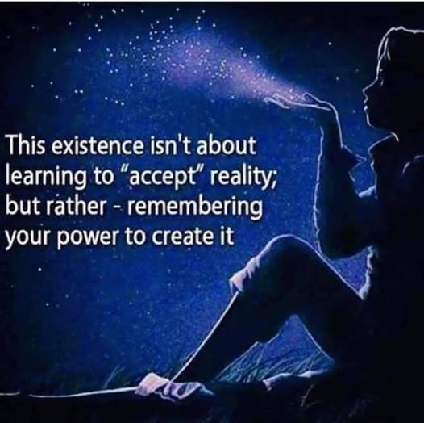
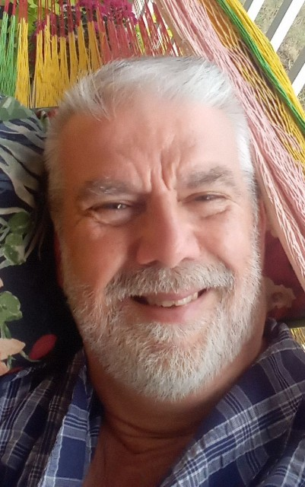
Ultimately it is YOU who will create the reality you choose to live in. By creating new positive thoughts for your mind to think will in time create a new kind of reality for you. This presentation is mainly MY EXPERIENCE....your challenge is to find YOUR OWN authentic self. I am here to assist on a donation basis & also suggest to check out my other presentations under the tab "Narrated Powerpoint Presentations" on reikiaccess.com......begin the adventure... the journey & work is worth it....
namaste David

