Slide 1
Creating a new choice of reality
Composed by David Benzshawel
? To david@reikiaccess.com

Slide 2
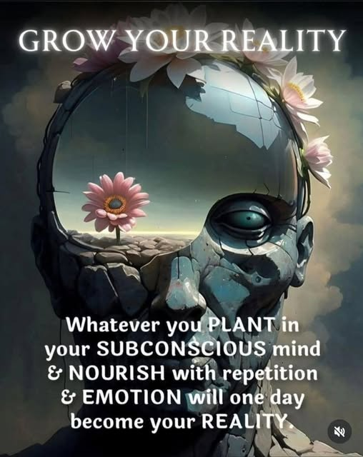
I would like to share some thoughts from my experience on my journey to discover my authentic self...this sharing is not meant to be advice but sharing resources I am using...so pick & choose which best appeals to you to try on for awhile

Slide 3
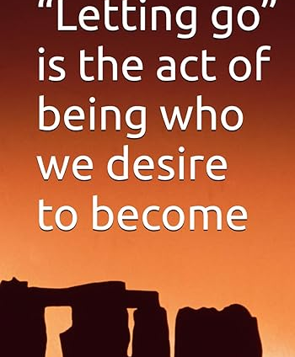
Let GO 2 Flow
Now in my retirement years, I have the time to reflect on my life and CHOOSE the kind of person I want to BECOME....for me I had to "let go" the past thoughts of could have, should have, would have...regreats & hurt....to strive to see a lesson in what happened & then work at staying more in the present moment with a grateful heart

Slide 4
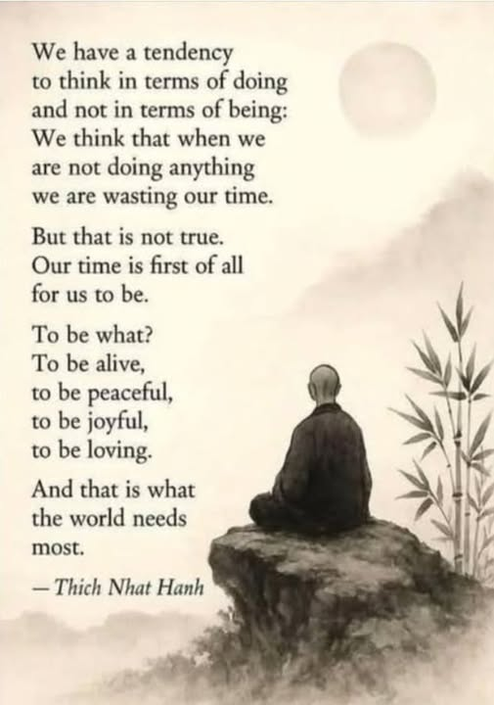
Doing or being?
I found I had to move from always wanting to "DO" something & slow down to "BE" my true self....as a recovering codependent I was a people pleaser to the extent I lost a true sense of my authentic self

Slide 5
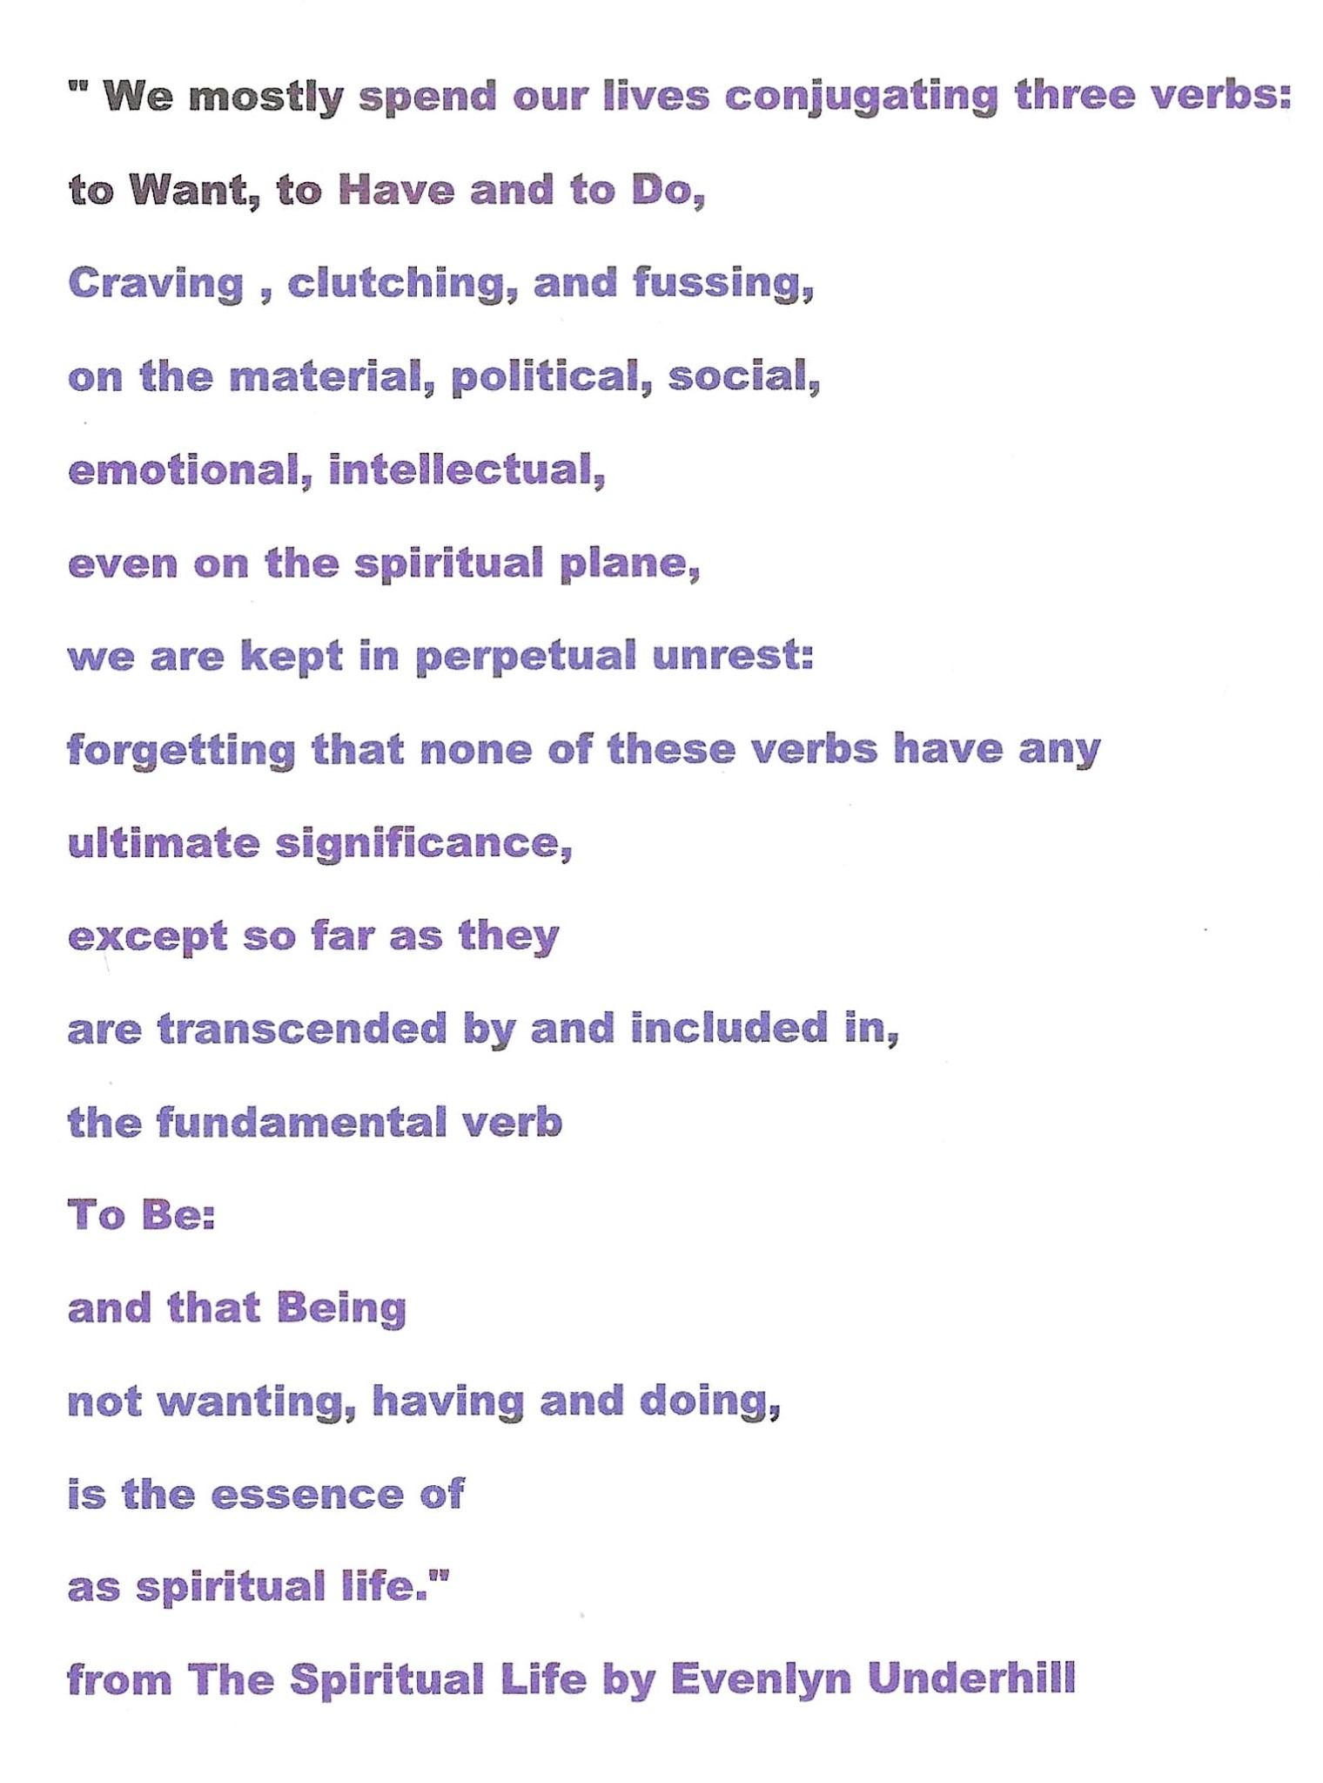
Being becomes my new reality
I never "fit in" to Religion as such...i tried to follow my heart but found it did not conform to traditional Religion....spirituality for me is my direct connection to SOURCE ...so it is highly personal & individual
This quote from Evelyn Underhill reminded me that spirituality/being is the foundation of my spiritual life

Slide 6
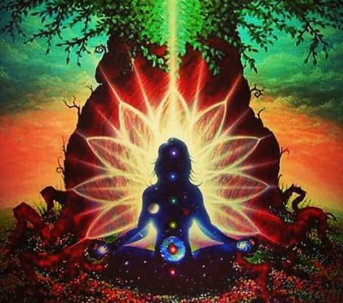
Meditation & reiki
These became the "tools" to calm & focus my mind & put my best efforts into finding balance & healing in my life

Slide 7
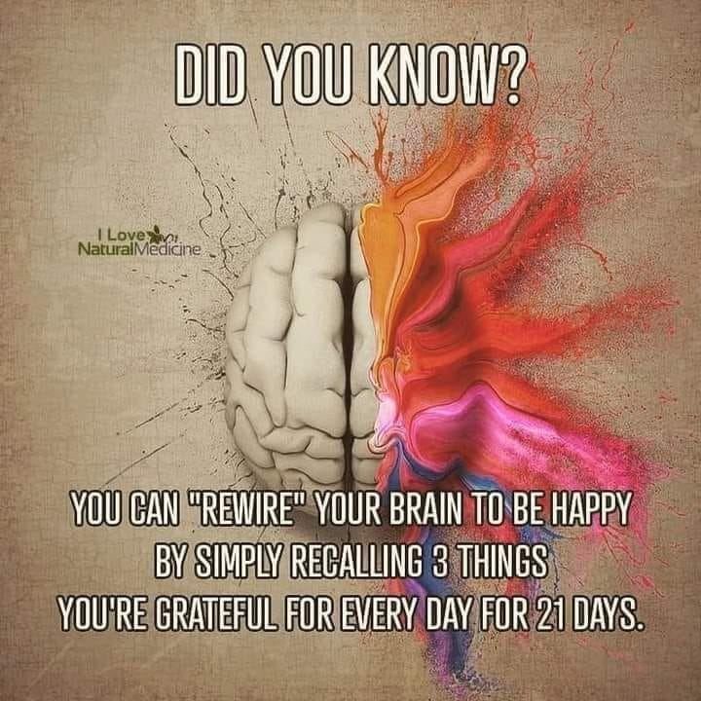
Re-wire the brain
The EGO wants everything to stay the same & does not want change but the SOUL wants to grow, thrive & learn in the midst of welcomed change....to do this I try to take the negative self talk from the EGO & re-phrase it into something more positive & inclusive for my growth

Slide 8
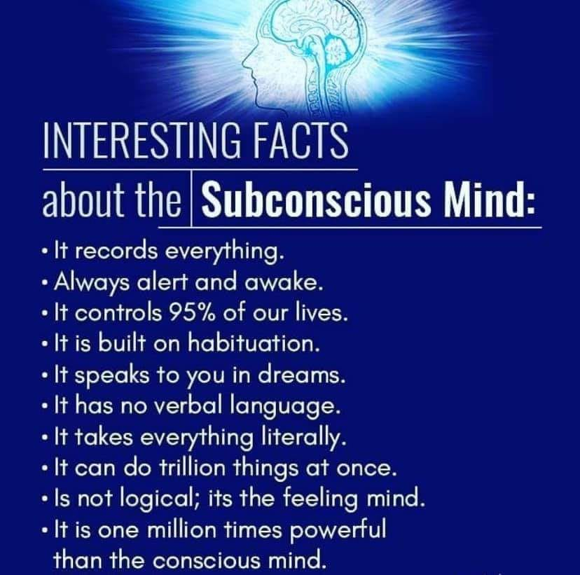
Soul/the subconscious mind
I have become a fan of Carl Jung who explained that the EGO is the conscious mind whereas the SOUL is the subconscious mind...for me I work at finding a balance between the two

Slide 9
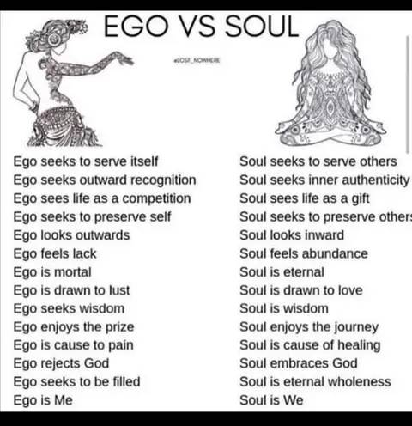
Is it either or?
I don't think for me I had to battle these two aspects of me against each other....life I feel is not a battle of black or white....finding balance for me is realizing it can be a "win-win" situation when I work at listening to both & striving to balance them so I can continue to grow

Slide 10
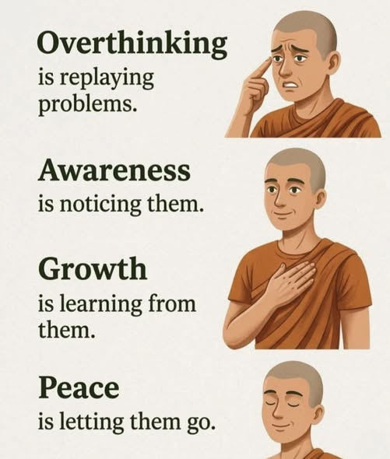
Moving from overthinking....
I don't want to BE stuck in the past ...
but fully open to the gifts of the present moment ….so I realized I can move beyond the past into the present moment... so that the future that can help me be more available for growth & lessons

Slide 11
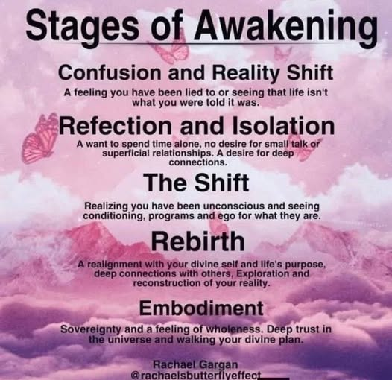
Woke...awaken to a new reality I choose
As I became more aware of my spirituality I began an AWAKENING process that was not a one time event but a spiral of growth that I went deeper into each day as I trust SOURCE to help me go with the flow of the present moment

Slide 12
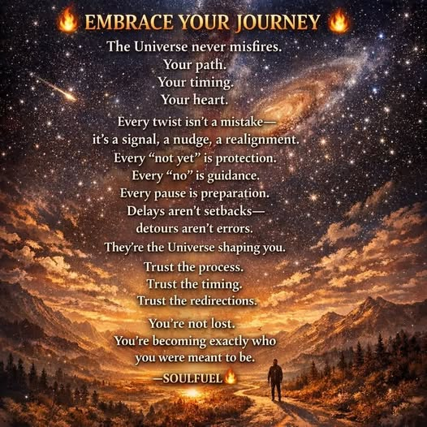
A journey into myself
I am NOT there yet ….each day is a new opportunity for growth & lessons to be learned....it is a journey that I now embrace....i am growing in trust & gratitude each day I keep myself open to change & balance by EGO/SPIRIT....yes it takes effort....but in the long run I am worth it

Slide 13
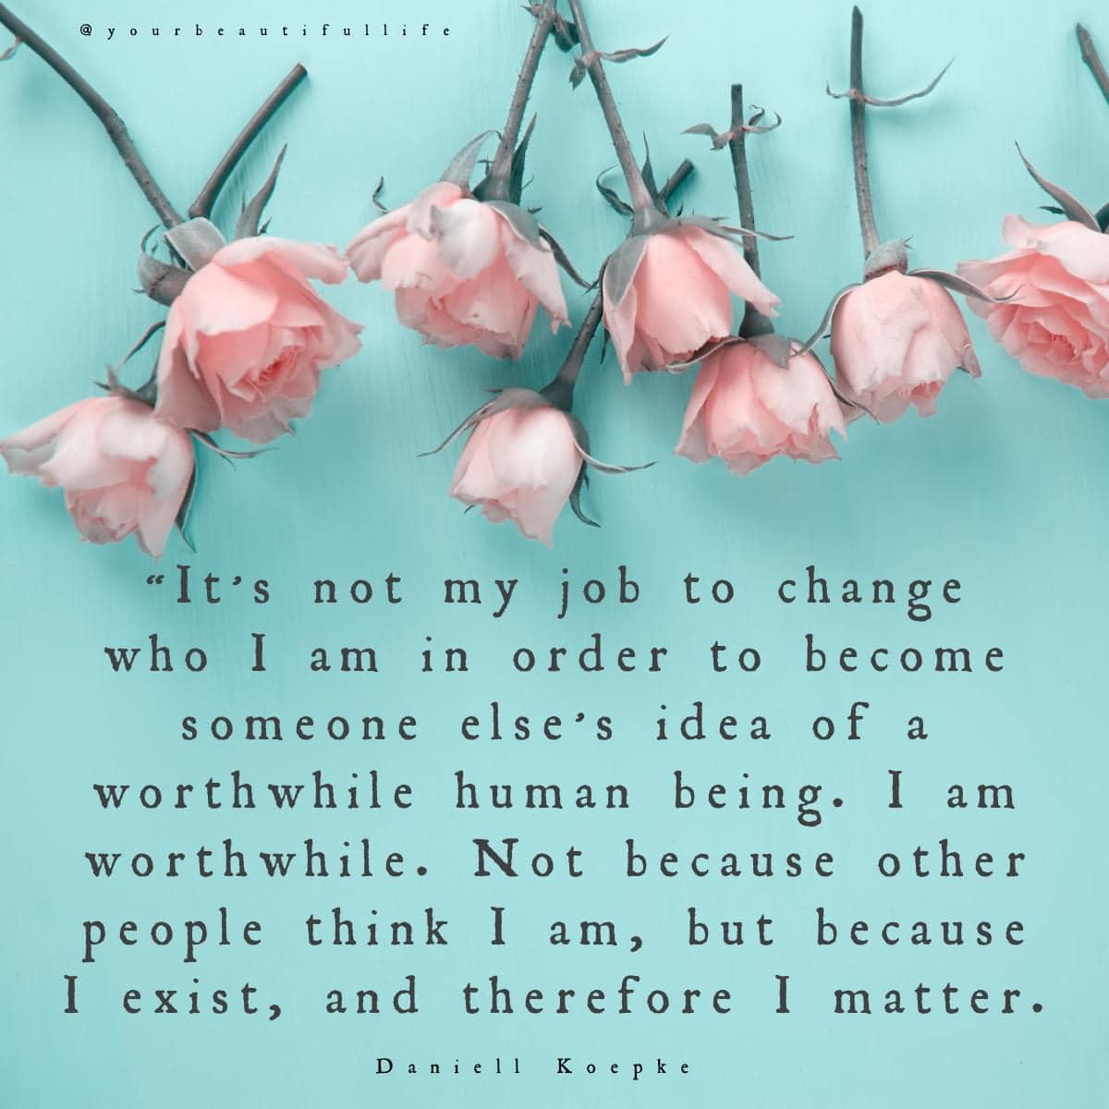
Learning self love & care
I am slowly learning that self love/care is NOT selfish or self centered....it gives me the ability to focus on the most important relationahip I will have in this life....MYSELF....a lesson that was a long time in coming for a recovering codependent who lost themself in pleasing others...i learn the best it seems from the school of "hard knocks" & the lesson repeats until it become one within me

Slide 14
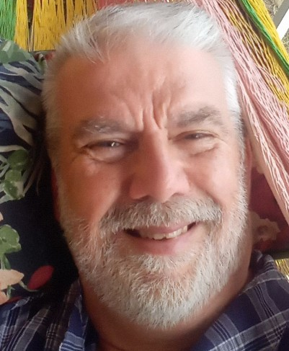
Find a reality that works for you....
I hope what I shared has been helpful for you...if an idea "resonates" within you try it for awhile....follow your heart/inner guru
Under the tab "Narrated Powerpoint Presentations" on reikiaccess.com you might find other topics that might be helpful in your spiritual growth.
Ram Dass said "our purpose here is to help walk each other home"
Namaste you all
David

