Slide 1

Authentic Spirituality composed by David Benzshawel
?s to david@reikiaccess.com
(only slides no audio)

Slide 2
What is Authentic?
Webster defines "authentic" as being actually and precisely what is claimed....
For me this means I share my experience rather than quoting others sources...i tend not to give advice ….but to share my journey in the hopes that parts of it may resonate with others. When I got my Licentiate Degree in Spiritual Direction/Spiritual Theology from the Anglican School of Theology in Dallas Tx....i decided my approach in working with others would be more of a "mentor" who gives a buffet of choices for the individual to choose what works best for them

Slide 3
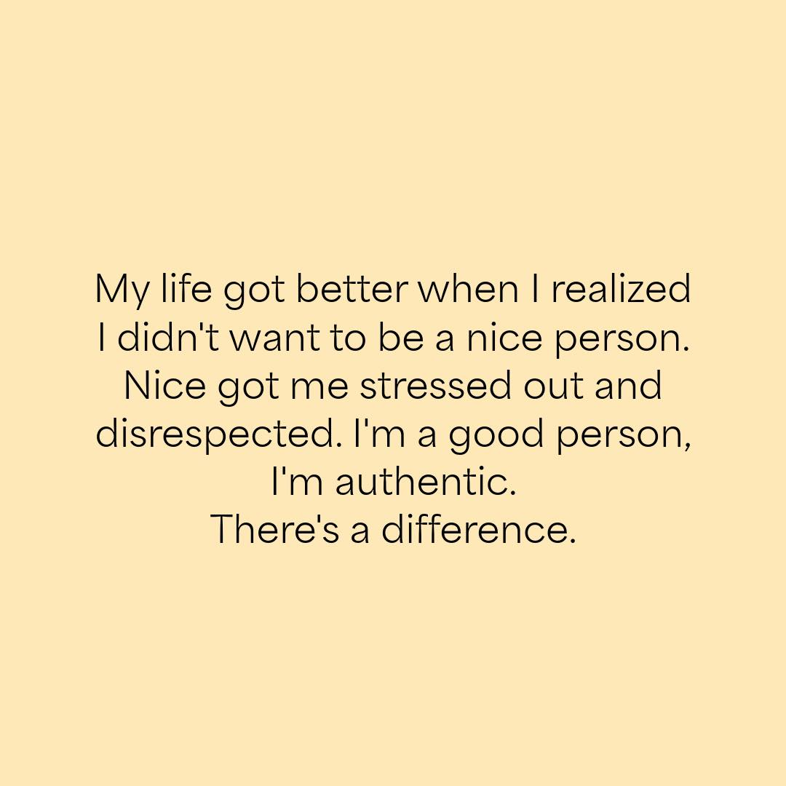

Slide 4
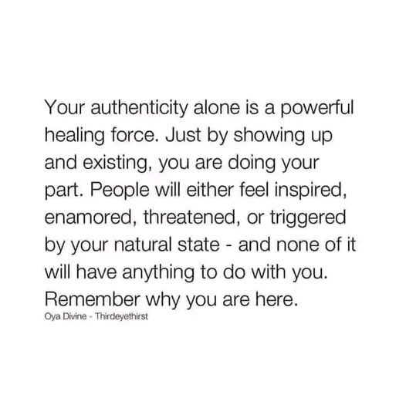

Slide 5
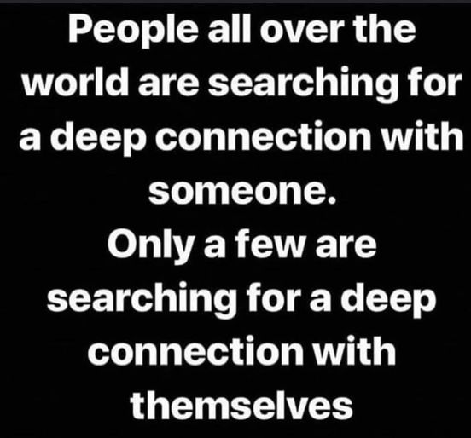
Know yourself first….
The most important relationship you will have in your life ….is with yourself.
Self care & love is not taught by society but must be learned from our own heart.
We might have negative self talk that we can replace with positive affirmations.
Make a friend with yourself…self knowledge like meditation is very centering, calming & empowering….

Slide 6
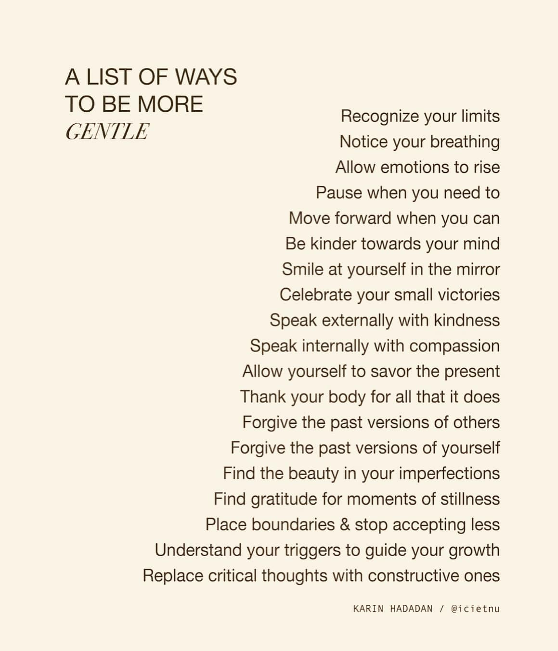

Slide 7
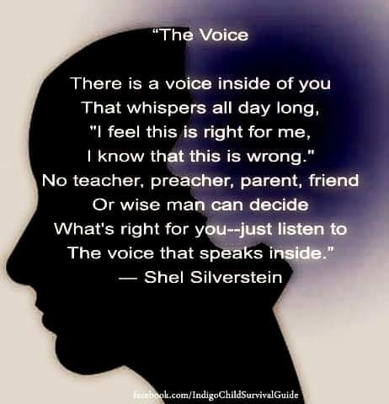
Listen to your inner voice…

Slide 8
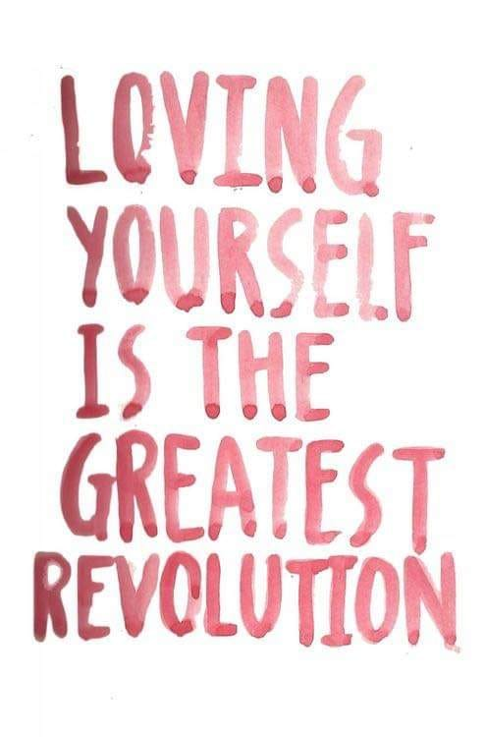
Learn self-love/care….

Slide 9
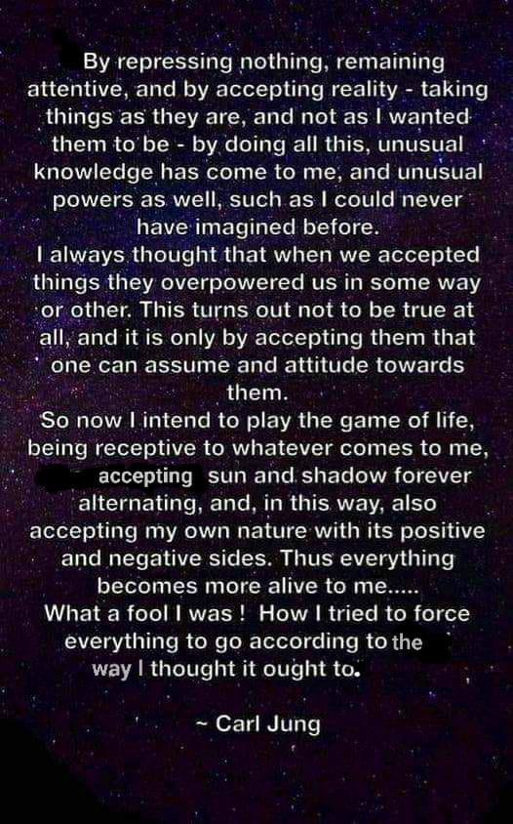
Mandalas…
One of the helpful tools I learned from the writings of Carl Jung is using Mandalas to help balance the conscious & sub conscious mind…if this concept is new to you check out the four part series on creating mandalas on my website reikiaccess.com under the tab narrated powerpoint presentations….

Slide 10
What is Spirituality?
For me spirituality is your direct & personal connection to the Source
You do not need to be involved in Religion to be spiritual
Reiligion is a human institution that seeks to build community & find a common foundation for others to share their spirituality.
Sometimes one needs to re-frame their image of Source
That is more supportive & affirming for their growth.
(If this concept is new for you I would suggest to view the presentation by the same name in the tab narrated powerpoint presentations on reikiaccess.com)

Slide 11
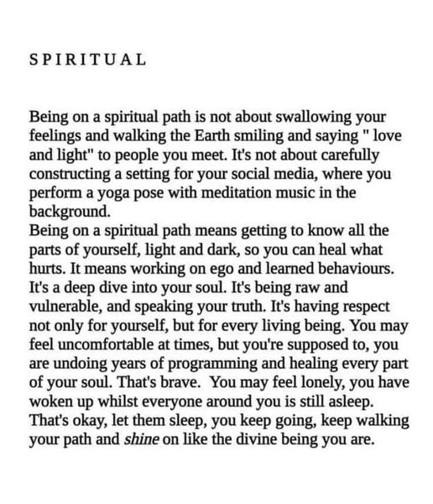

Slide 12
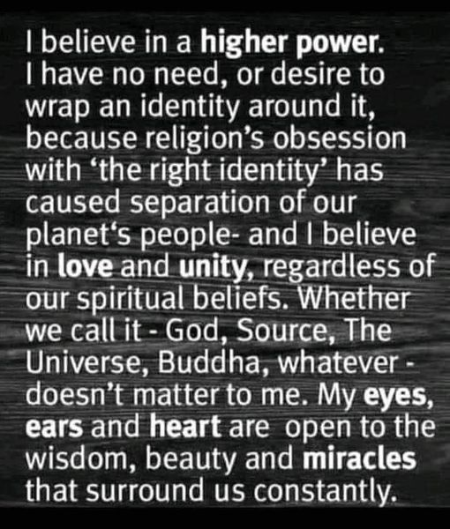
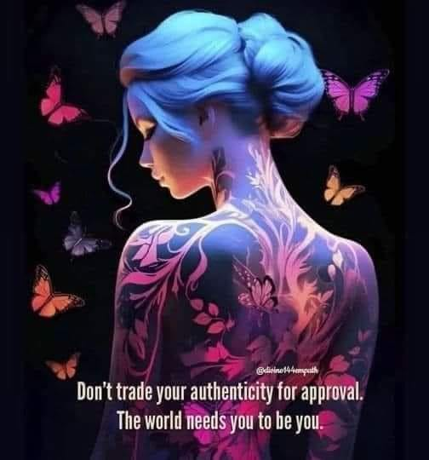

Slide 13
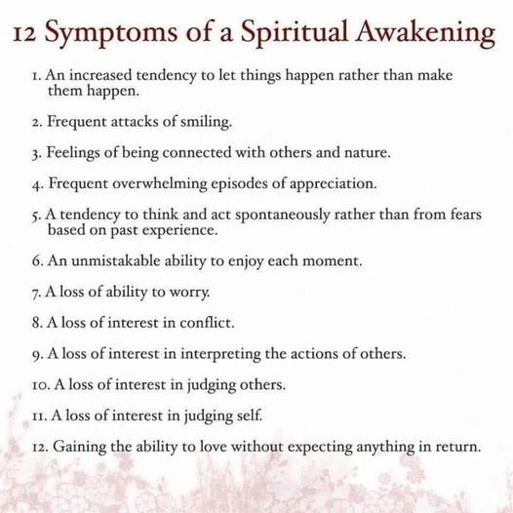

Slide 14
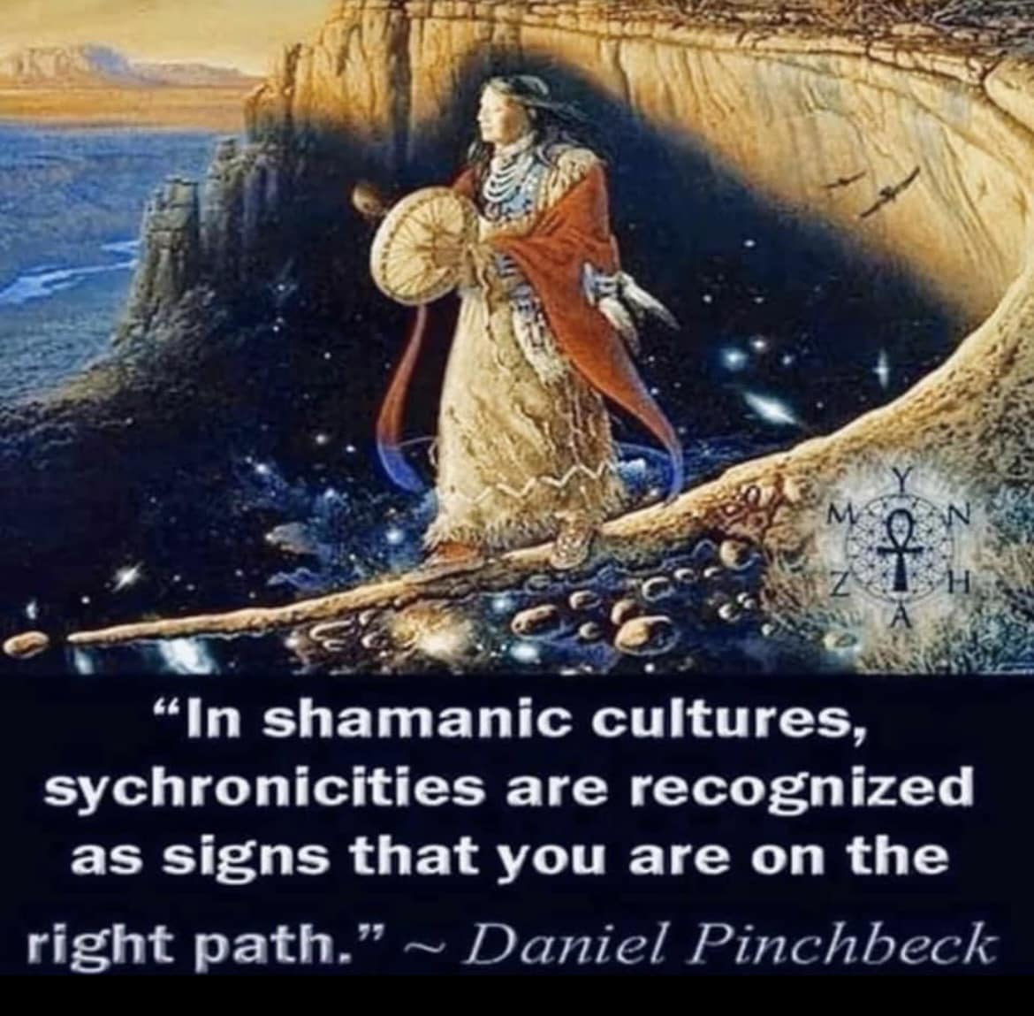

Slide 15
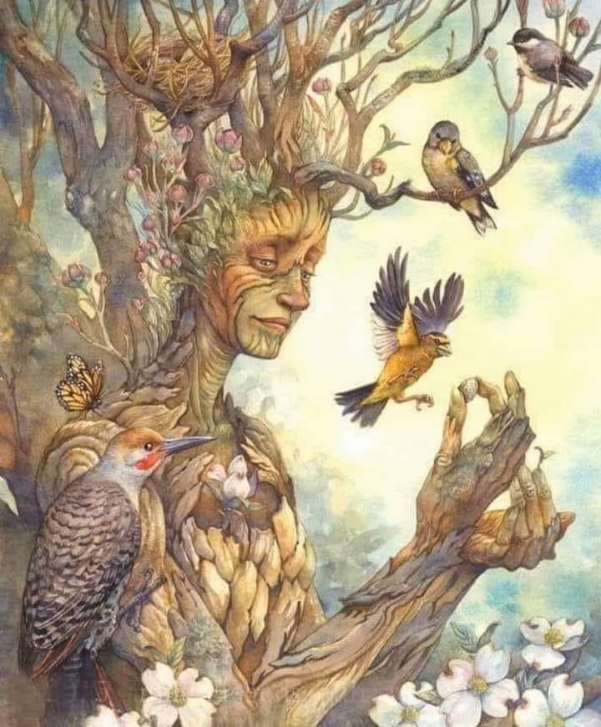
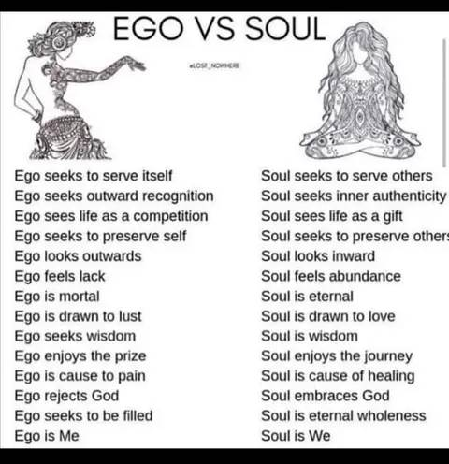
Being Interconnected
For me I believe that all life is interconnected....i especially experience this when being in Nature. I feel we humans have more in common than what seperates so much so that seperation is an illusion when we see others a part of the whole...Finding a balance between the Ego & Soul helps in embracing this approach to life….see the four part Series on the Mandala to help find the balance between the ego & soul on reikiaccess.com under the tab Narrated Powerpoint Presentations
1st Event | 2nd Event | 3rd Event | 4th Event | 5th Event | 6th Event
Date | Date | Date | Date | Date | Date
Description | Description | Description | Description | Description | Description

Slide 16
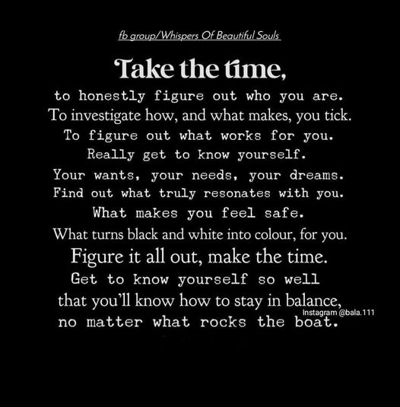
i think time is a human construction....past, present, future exists together...it manifest itself by what i focus on....when i retired at 62 i made these promises to myself...i will learn something new each month, i will be more creative, i will thrive not just survive, i will evolve not just retire, i will see these golden years as my second childhood seeing all with new eyes of wonder as a child, i will discover my true self, i will practice more self love, i will take time each day to meditate, i will listen to my body more, i will live my life more unstructured so i can respond more quickly to the present moment, i will choose to BE HERE NOW, i will say thank you for whatever is happening in my life....that was 8 yrs ago & so far it is going well....i am alone but not lonely and know myself better than all my previous years....how will u used your time?..

Slide 17
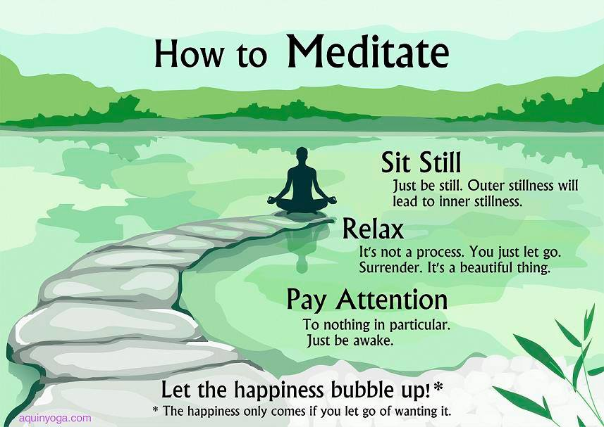
Learning to Meditate
Meditation helps to calm & focus the mind....there are many different ways to personalize it. If you have Netflix check on the HeadSpace series Guide to Meditation or "Seven Easy ways to Meditate" at reikiaccess.com under the tab narrated powerpoint presentations.

Slide 18
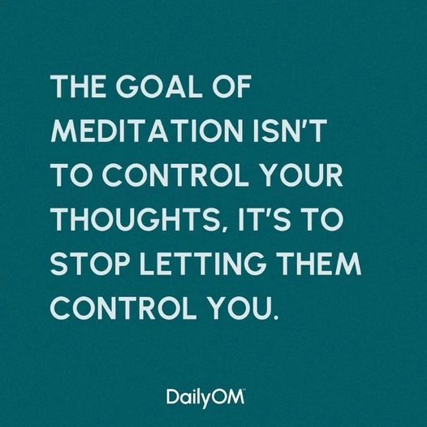
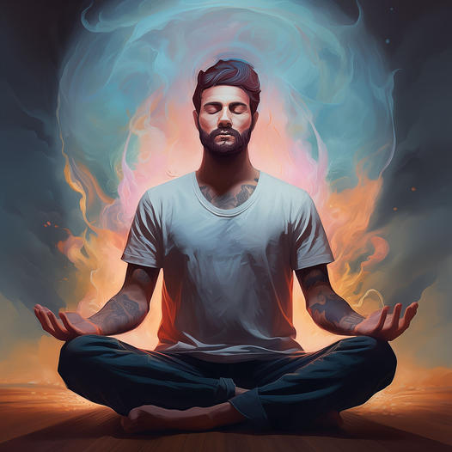
Meditation helps calm our monkey mind….

Slide 19
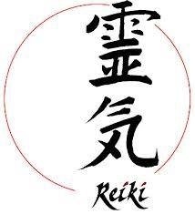
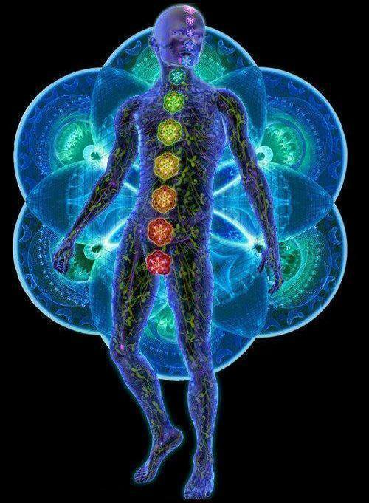
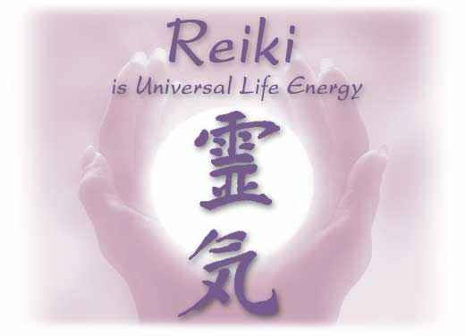
Learn Reiki/Energy Systems
30 yrs ago I first learned Usui Reiki and was so excited that I went out & learned 130 different reiki/energy systems & started teaching online through reikiaccess.com (you can learn online for FREE the first two levels of Usui Reiki on homepage just click on link “Where to Begin”
Eventually I realized my passion was helping others not only about their unique spirituality ….i began to help others discover their own energy systems

Slide 20
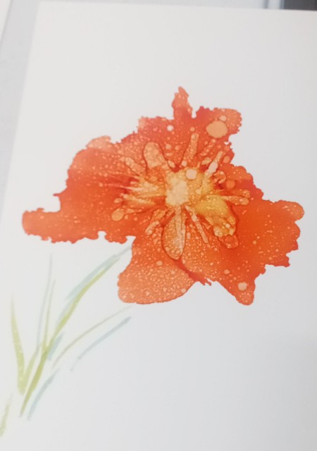
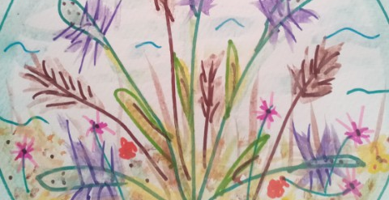
Creativity helps spirituality grow
2 yrs ago when I moved to Port Aransas I took two water color classes….I also started facebook page DP Mandala Art where you can see more of my artistic endeavors.
I found that I have a creative soul that needs to be expressed & in doing so I believe it helps me grow spiritually…realizing that I am co-creator of the reality my mind chooses to focus on.
I now walk the beach with the dogs & give away bracelets I make from shells I find on the beach…the joy on the receiver's face is priceless

Slide 21
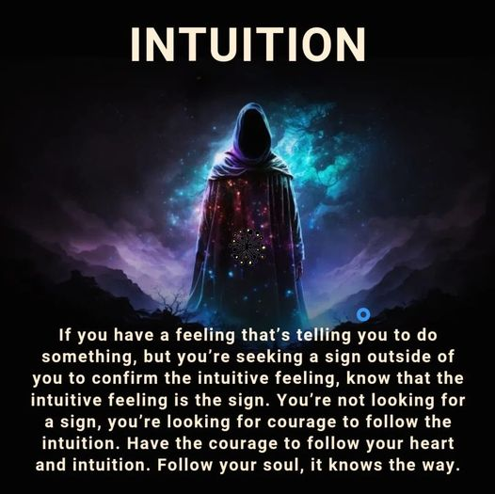
Find your inner guru/intuition…
A major step for me in creating authentic spirituality is beginning to trust your gut/intuition. For me it is a way my spiritual guides help direct me…but like any change it takes time to trust your psychic abilities…learning reiki helped increase it allot as I used reiki everyday. No one should need to tell you what in your inner work you can discover for yourself….you are unique & special…not able to fit into the “norm” so trust the vibration around a decision & remove toxic people/energy vampires from your life

Slide 22
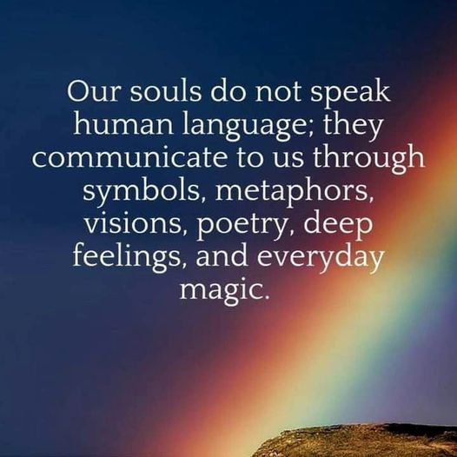
Listen to your soul….

Slide 23
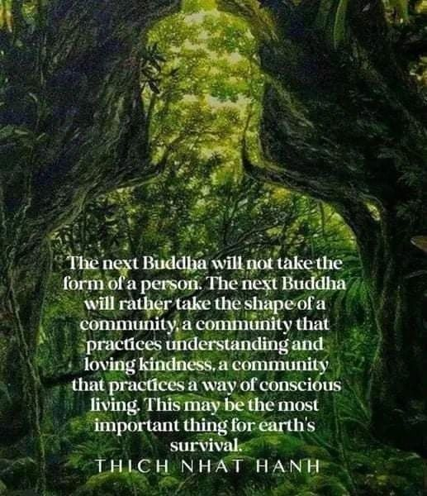
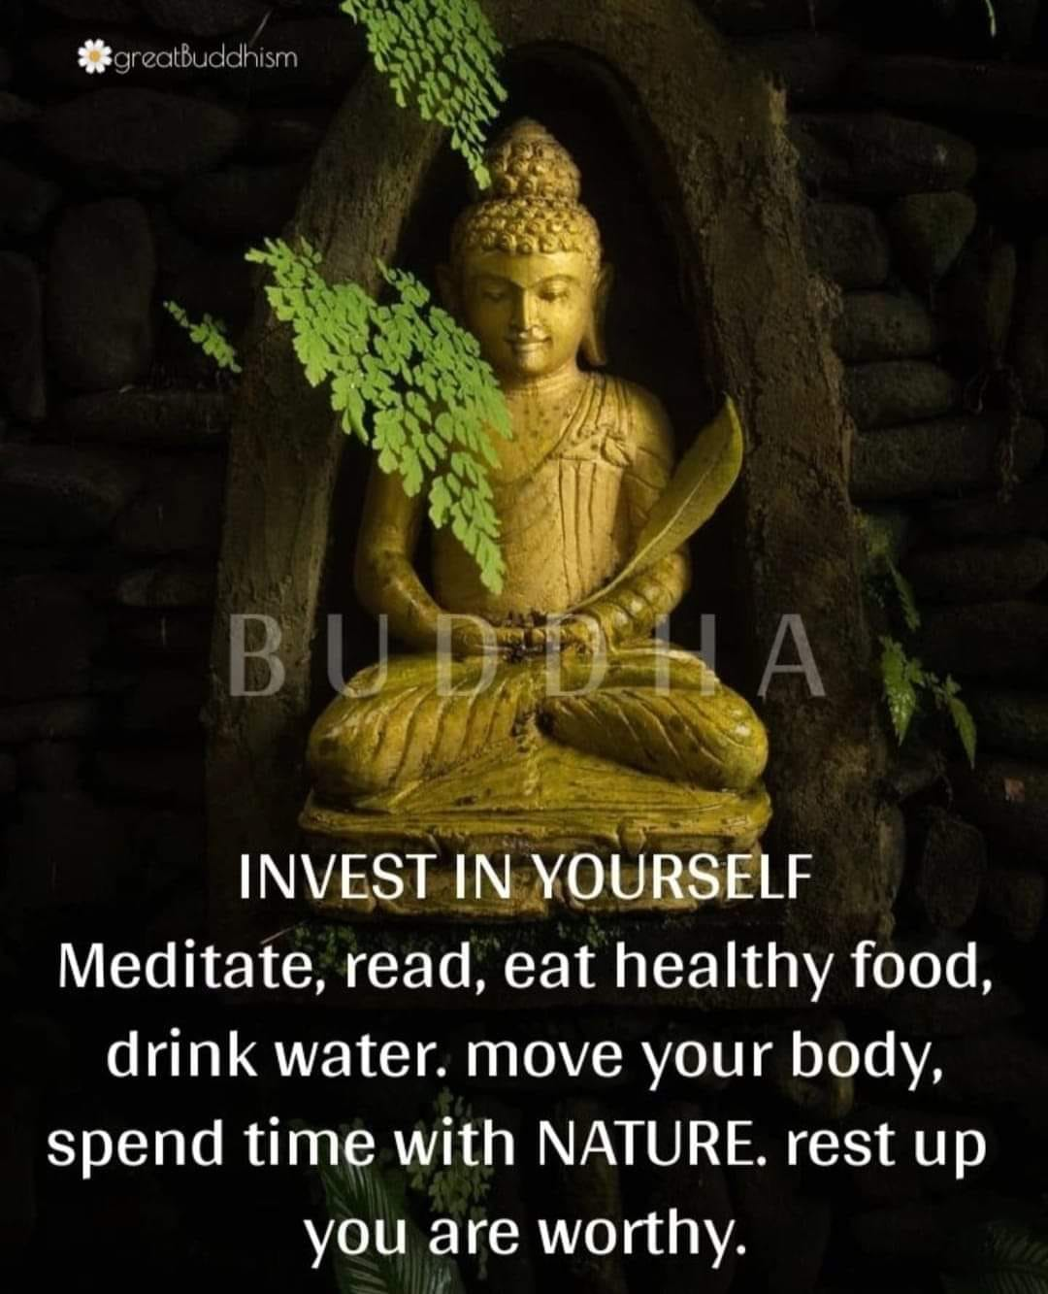
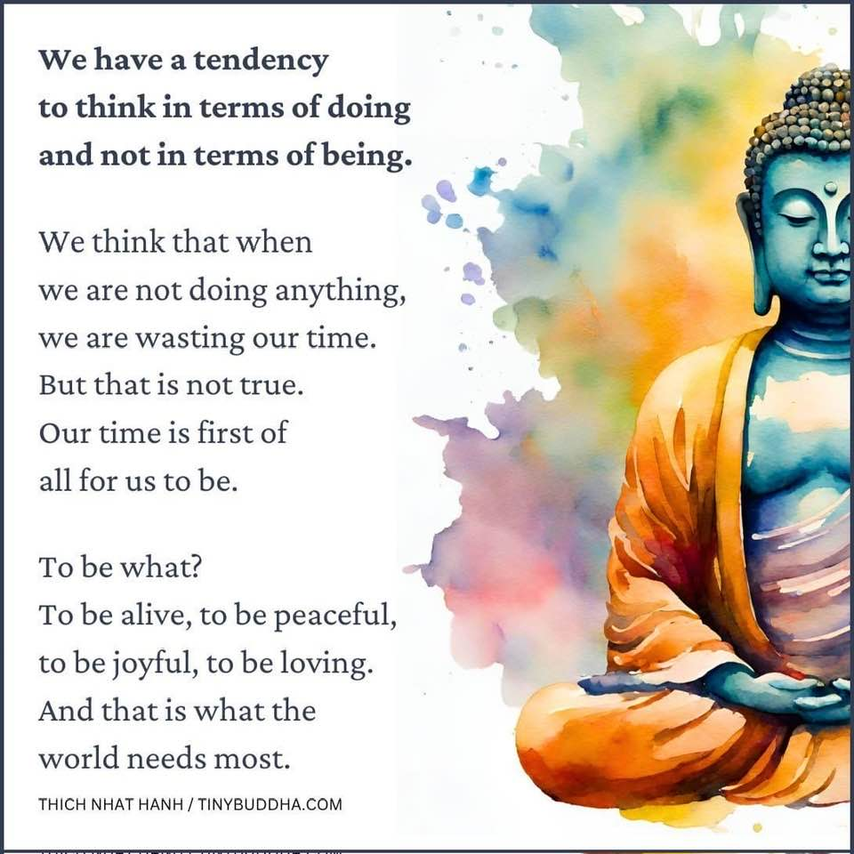
The coming Buddha….

Slide 24
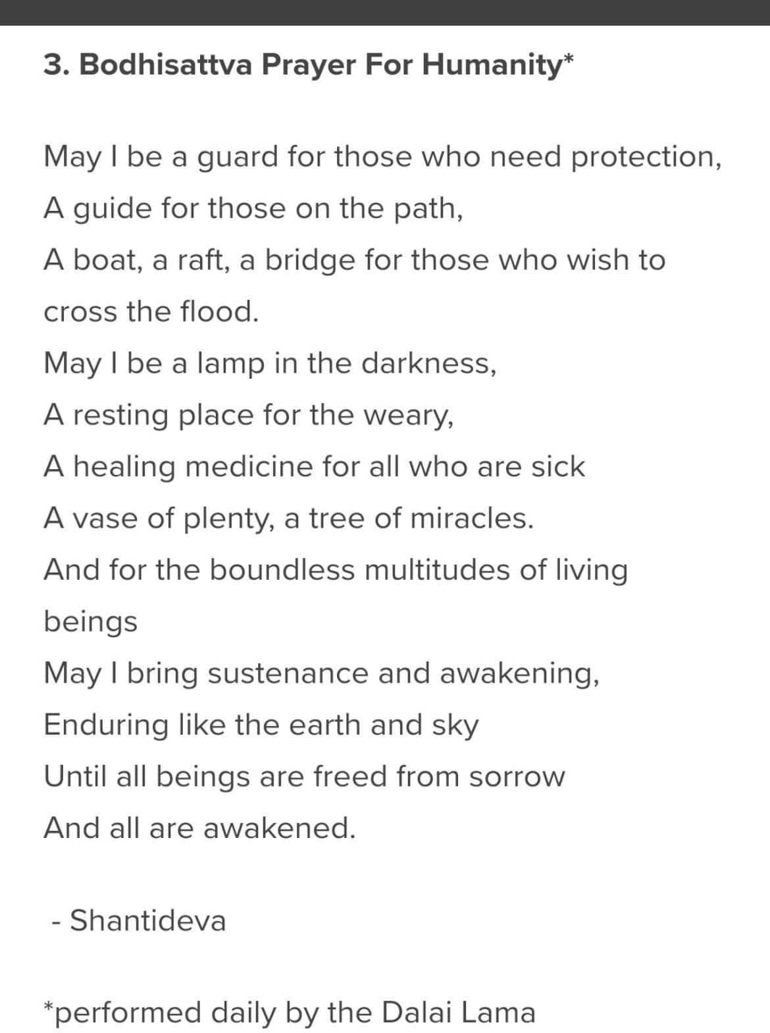
A life of service….

Slide 25
Conclusion
It is my hope that this sharing from my perspective has created some areas that resonate with you…if so try them for awhile.
For me being a Mentor is not giving advice but speaking from my experience in giving you a buffet of options for you to choose for yourself. I am here to assist you….?s to David@reikiaccess.com

Slide 26
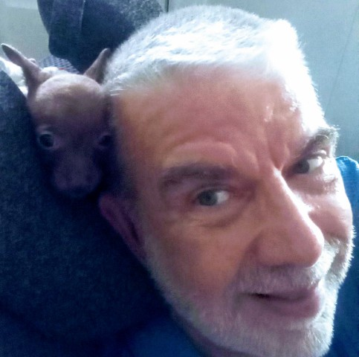
My journey:
Even though I was a cradle Roman Catholic I never really had a spiritual awakening until High School when I met the Jesus People & Charismatic Renewal. At a early age I felt a call to become a priest but my parents wanted me to have a normal high school experience & then could enter seminary after high school. I attended a Diocesan, Franciscan & Graduate Seminaries. I never really “fit in”. I made a month long Observership with the Trappists but even though I knew I was contemplative by nature I still felt called to be of service by living in the world of strife. I was ordained a priest finally 42 yrs ago in the Old Catholic Church & pastored 3 churches full time with UFMCC. I burnt out & realized my gift was more in mentoring so I got a Licentiate Degree in Spiritual Direction/Spiritual Theology from the Anglican School of Theology in Dallas Tx in 1998. I feel more called to serve one on one or small groups now. I would describe my spiritual path now as a pagan buddhist. I have a website reikiaccess.com & various FaceBook pages reaching out to over 20k fb friends. Please feel free to email me your ?s at david!@reikiaccess.com

Slide 27
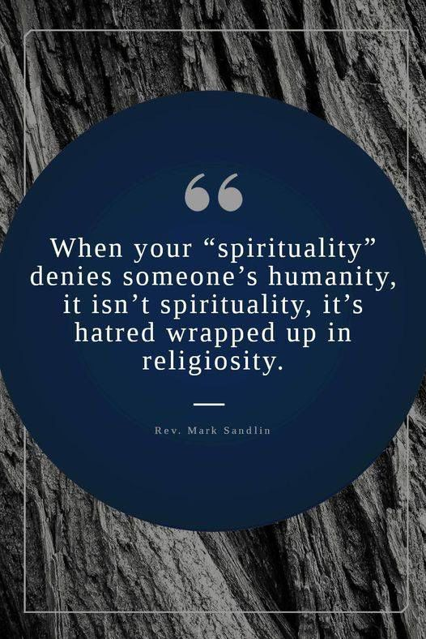
Resources
I share a monthly presentation online that you can find copies of at
Reikiaccess.com
Under the tab Narrated Powerpoint Presentations
On various topics of a spiritual nature
I hope you will find these presentations helpful on your developing spiritual path
Namaste you all…..David

