Slide 1
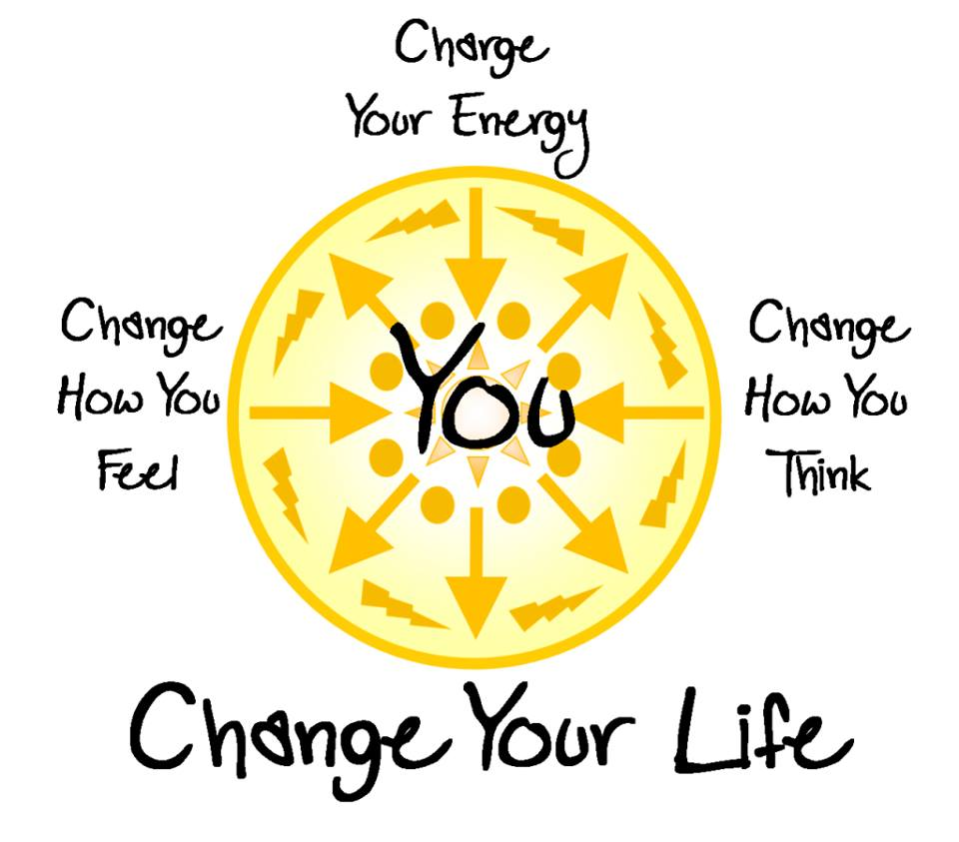

Spring into Wellness…
What is
Spirituality?

Slide 2
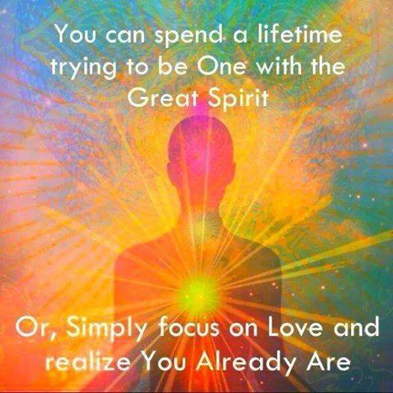
Religion:
is a human institution that seeks to find common ground in spiritual experience through ritual & dogma to establish a community of same believers.
Spirituality:
is an individuals unique experience of their connection with God or Source in an intimate connection through
personal communication & symbols, meditation & reflection.

Slide 3
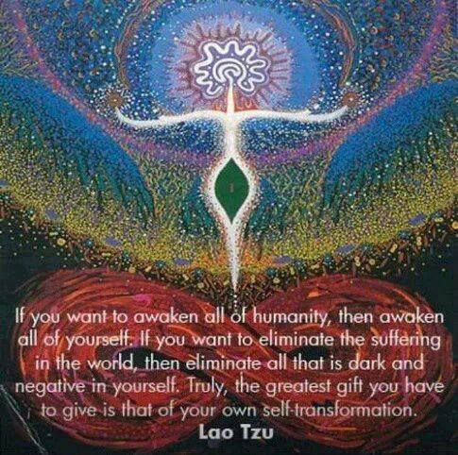
In the past decade the number of people attending church on a regular basis has been declining…
Whereas the number of people who describe themselves as more spiritual than religious is increasing.
More people are seeking a spiritual connection than joining an institution.
Spiritual Director/Mentors:
are guides to help one discover & develop their spiritual experience through dialogue, use of images & spiritual practices seeking a deeper connection with God/Source

Slide 4
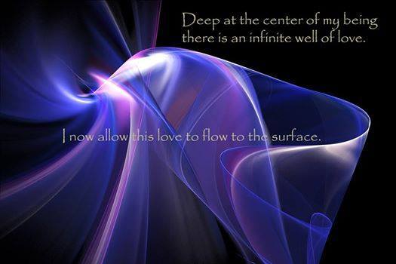
Meditation:
is a spiritual practice to quiet & center ones thoughts so that they may hear & experience a deeper connection with God/Source.
Prayer:
is a dialogue with God/Source
including requests for healing & special needs.
Contemplation:
is being in the presence of God/Source in a wordless connection/gazing on the Beloved.

Slide 5
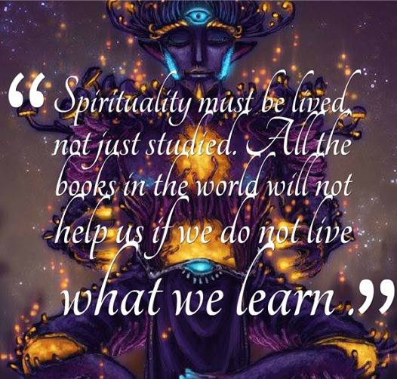
Service: is Spirituality that is lived out in the service of others… benefitting not just the person giving but also the person receiving…
Love in action to help make a better world.
Showing others what you believe by your actions & not merely your words.

Slide 6
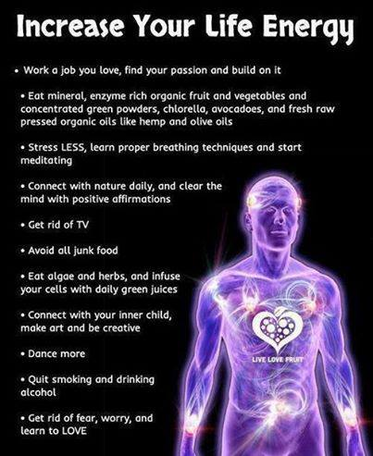
Be EMPOWERED to make positive choices for yourself this weekend…
Explore new ideas & images that RESONATE with your spirit…
Think outside your BOX of comfort & experience…
In order to EXPLORE new aspects of yourself.
CUSTOMIZE your approach to spirituality that best fits you & where you are at right now.
ULTILIZE the resources available to you by new practices, reading, sharing and just BEING a new & improved you.
LISTEN to your INTUITION
And follow your HEART and not just your MIND this weekend….

Slide 7
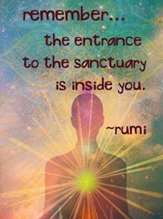

Slide 8
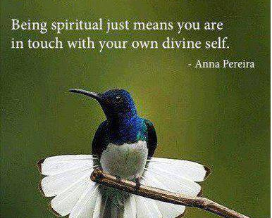

Slide 9
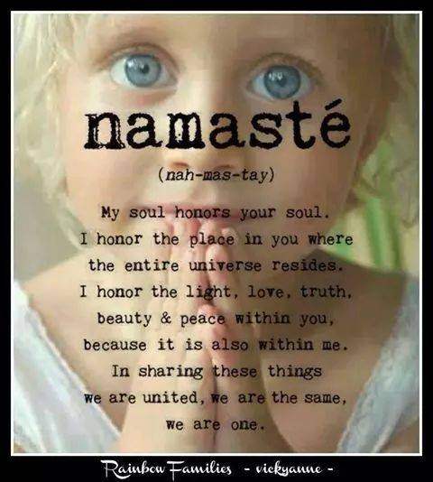

Slide 10
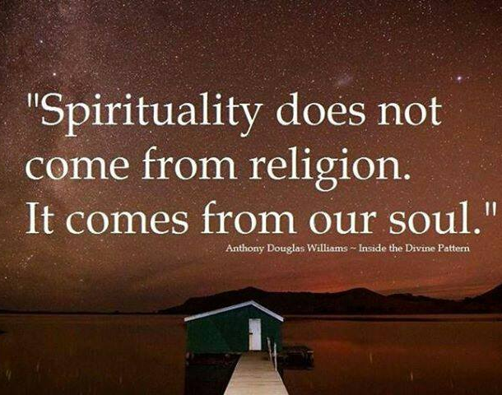

Slide 11


Slide 12
