Slide 1
Spiritual creativity
Composed by David Benzshawel
Send ?s to david@reikiaccess.com

Slide 2
What is spirituality?
For me Religion is a human created institution that seeks to form community with use of doctrine & dogmas...
Spirituality is your direct connection to Source

Slide 3
Why creativity?
For me I think I am called to BE co-creators with Source of my reality & purpose....
BEING creative helps me grow & thrive spiritually

Slide 4
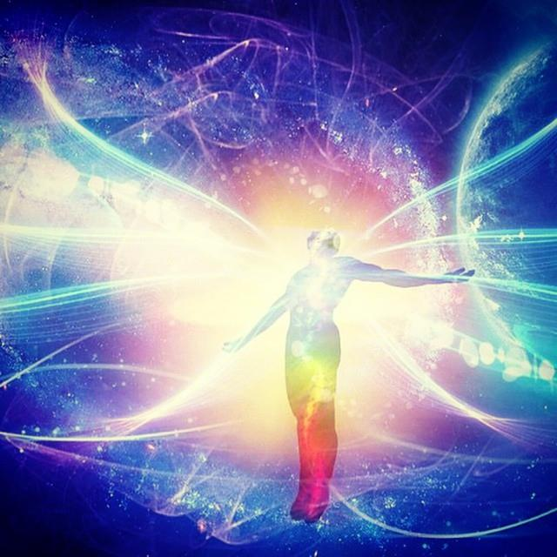
Move from DOING to BEING.....

Slide 5
Learn just to BE....

Slide 6
Where to begin....
If meditation is new to you....
check out on Netflix "guide to meditation" for 8 ways to meditate

Slide 7
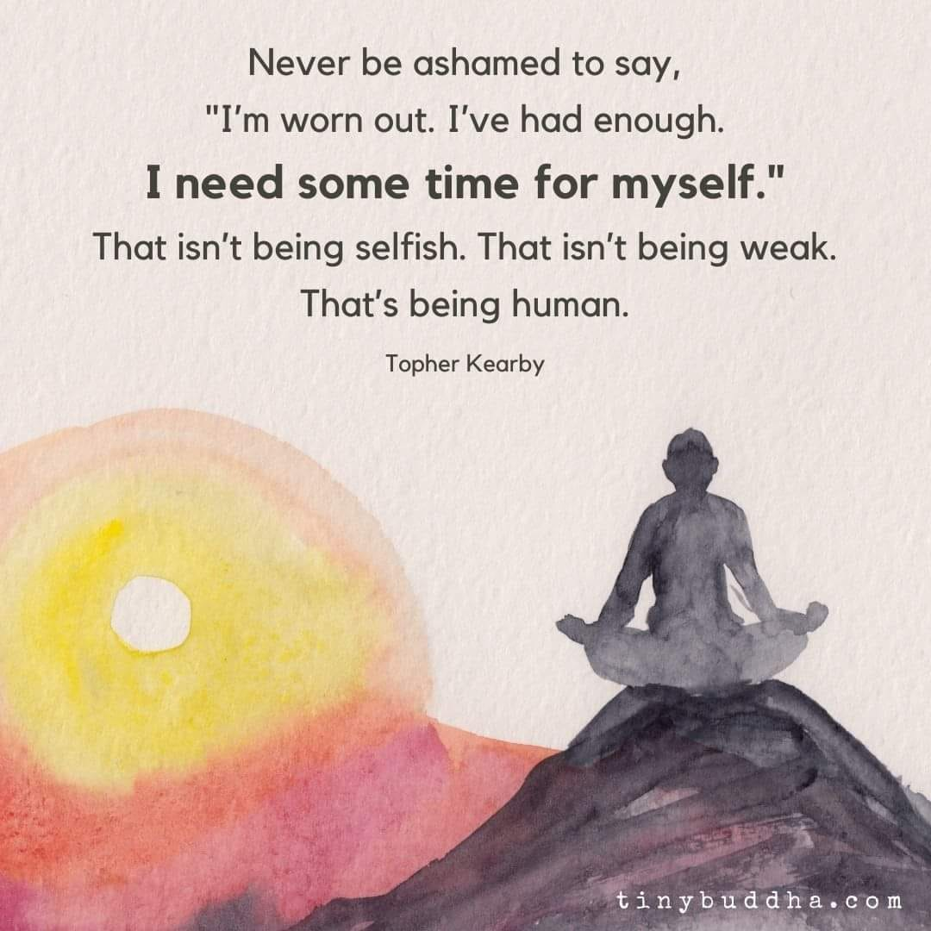
Take time to create a peace filled mind...
The buddhist say we have a monkey mind that jumps from thought to thought..
to find calm may require some mind training to find it.

Slide 8
Why meditation? Why will it help?

Slide 9
Calm, focus & center the mind...

Slide 10
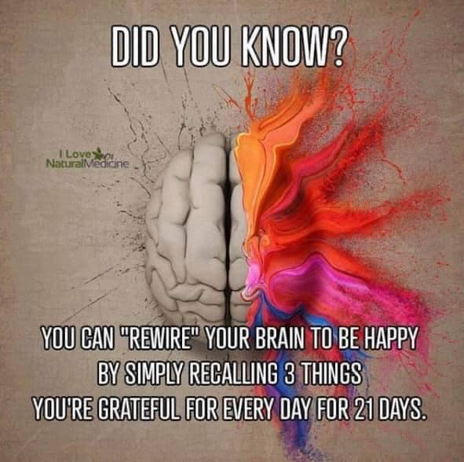
Rewire the mind....
Reframe negative self talk into something more postive that reflects your present reality....not the past self....be kind to the real you

Slide 11
Create the you that is authentic
Through practicing self love/care strive to find the REAL you & make friends with yourself...this transformation not only aids you but the world....

Slide 12
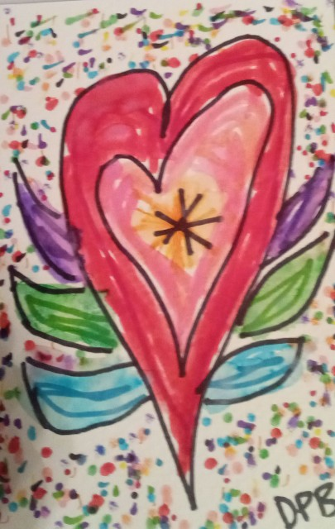
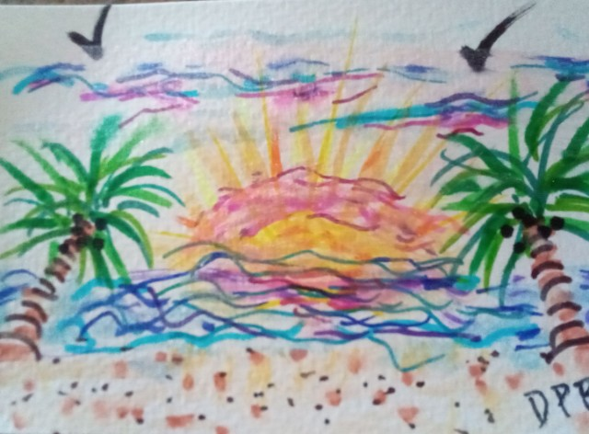
Learn a new passion....
When I retired to live on the ocean in port aransas tx I took a water color class for the first time since high school...when I paint it feeds my SOUL

Slide 13
Learn something new each month...

Slide 14
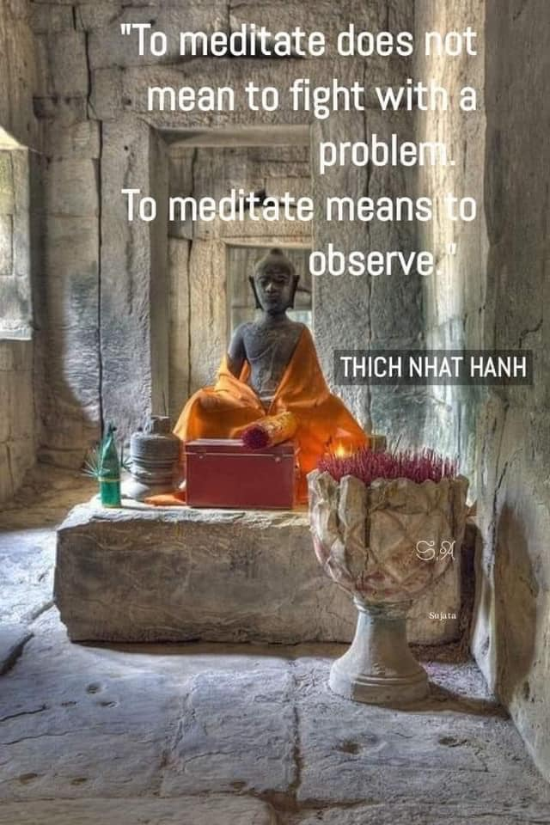
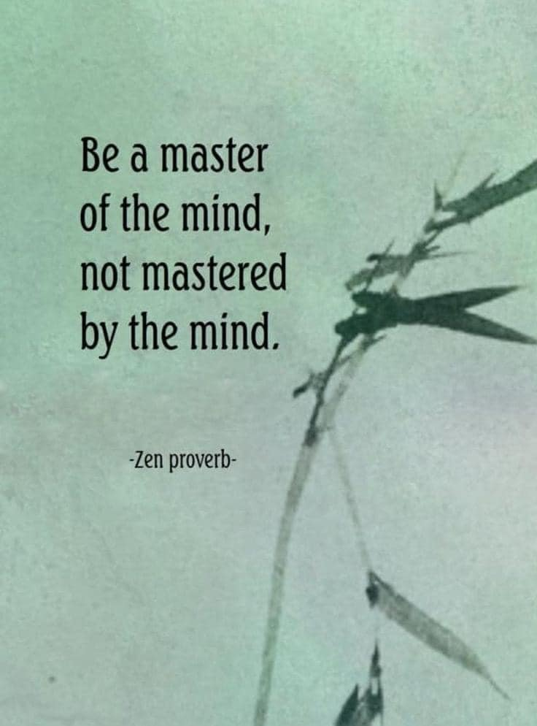
For me meditation & self care/love began the process
They helped create a new space to explore...
To remember the joy of play...
To create to express my feelings....
I want to thrive not just strive...

Slide 15
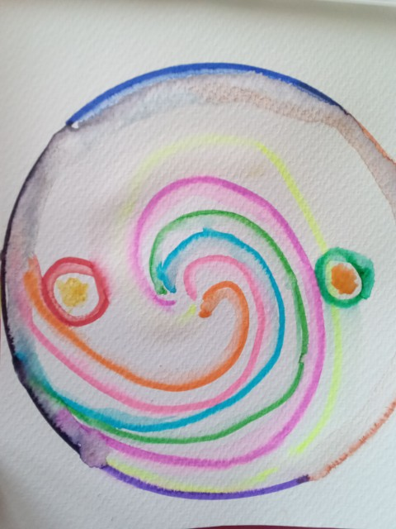
It is my hope that sharing these thoughts might inspire you to let your spirit soar by creativing the life you want

