Slide 1
Finding your hidden treasure...
Composed by David Benzshawel
?s email david@reikiaccess.com

Slide 2
Join me on a treasure hunt.....
Now that I got your attention I am going to share from my personal experience how to get in touch with a treasure within you that you might not even know about.
Better than silver or gold, it is exploring your SOUL your personal inner Guru/Intuition....which is our connection point with SOURCE or whatever you choose to call it since it is unique to you.

Slide 3
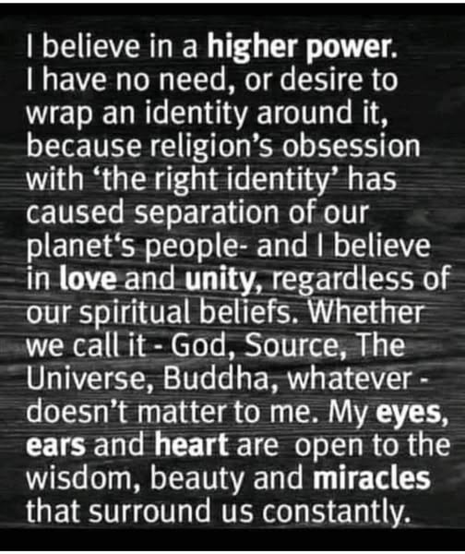
Words that fit your image...
Many of us have only been raised with the image of God as masculine but for those you have had abuse find a image that is nuturing & supportive for you
My image of Source is the ocean & waves that wash over me
Find your own image that best fits your spiritual journey

Slide 4
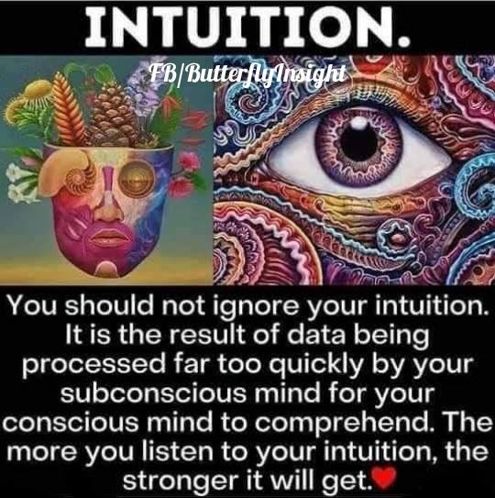
Your inner Guru
I am sure you have experienced a "gut feeling" about what you should decide to do
It is your inner voice of your SOUL/subconscious that is trying to help you make the best decision for yourself
This is part of the treasure we are going to explore

Slide 5
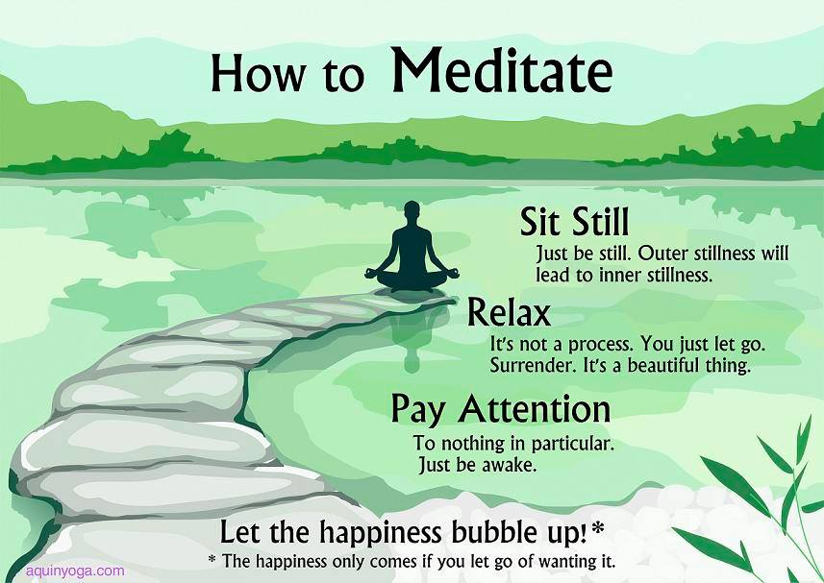
Using your new word/image...call out
Meditation is a good place to begin to strengthen your connection to SOURCE
Meditation is mind training to calm the mind to keep it focused & peaceful
A helpful aid if you have Netflix is the series "Guide to Meditation"
For me...prayer is us calling out to SOURCE....meditation is listening for a response...contemplation is just being happy being in each others presence

Slide 6
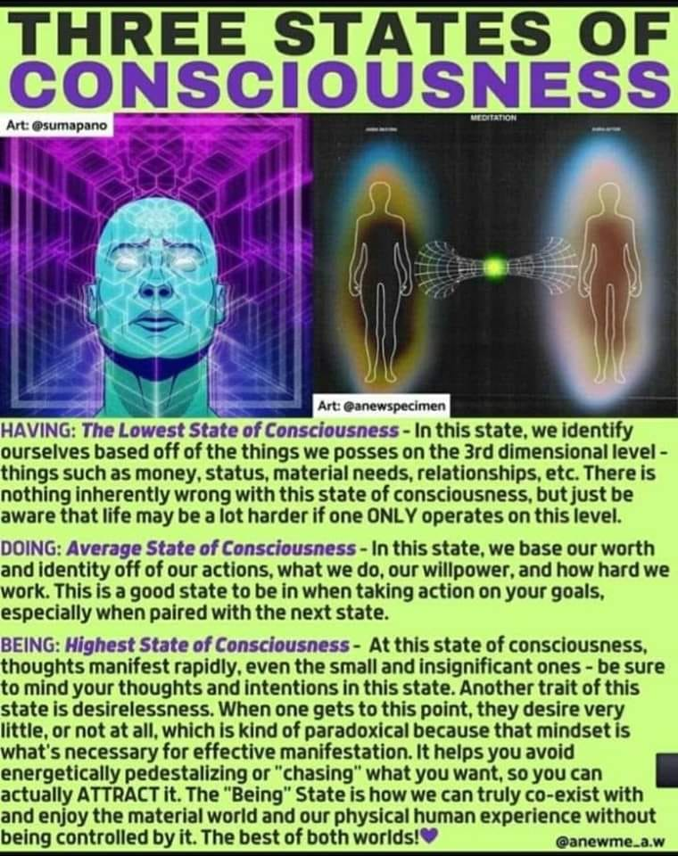
Meditation once a daily event....
Once you are meditating on a regular basis, you may begin to feel new levels of consciousness
We start with HAVING which the EGO gathering things & possessions to help us feel safe
We continue with DOING which is work/getting money to support ourselves
For me BEING is what I want to explore more with you since it is the beginning point for me of a spiritual awakening...

Slide 7
What is BEING?

Slide 8
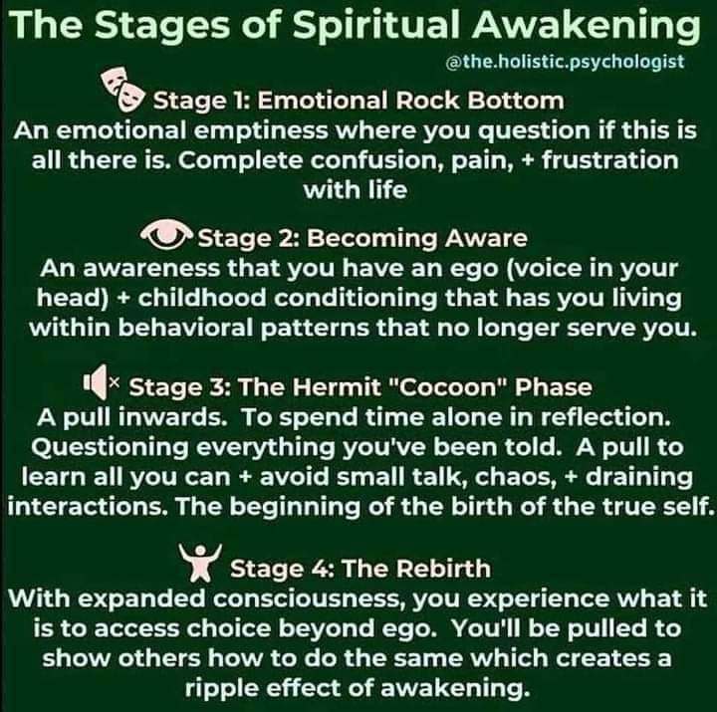
What is awakening?

Slide 9
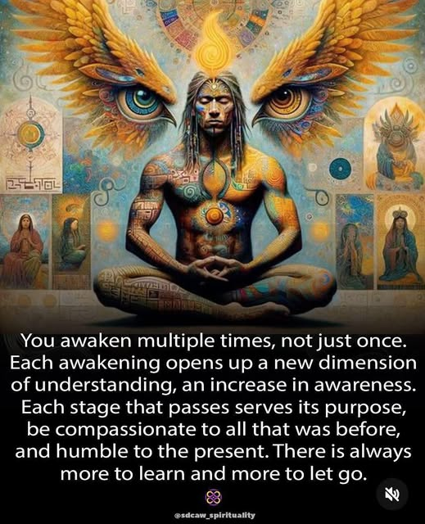
Awakening is NOT a one time event....

Slide 10
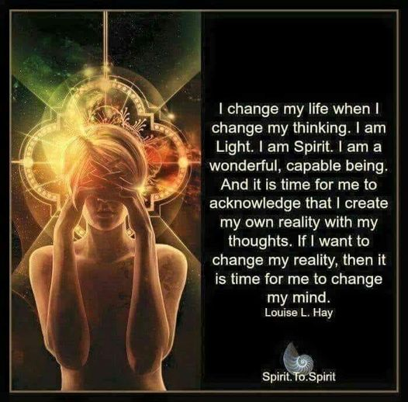
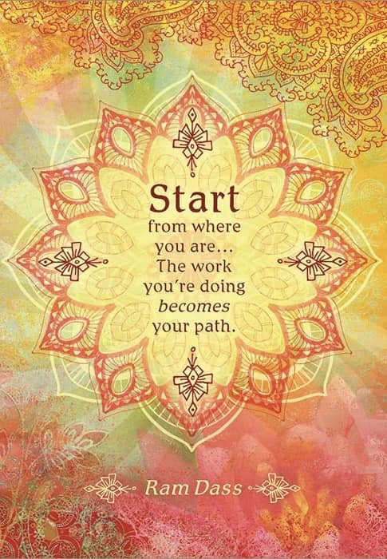
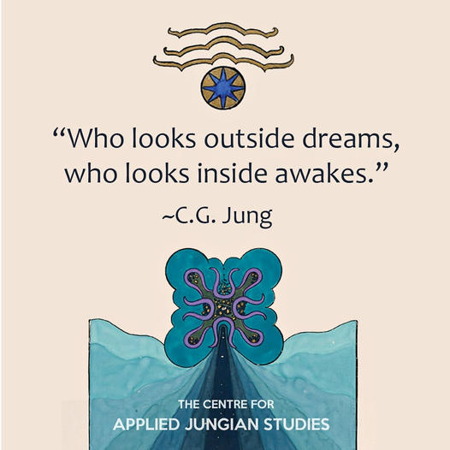
Where else can I turn for help....
There have been many spiritual authors who help me...Louise Haye, Ram Dass, Carl Jung....find an author that resonates with you....

Slide 11
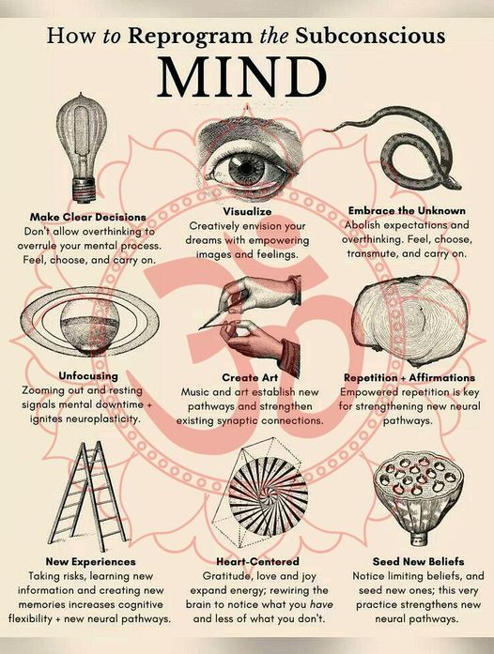

Slide 12
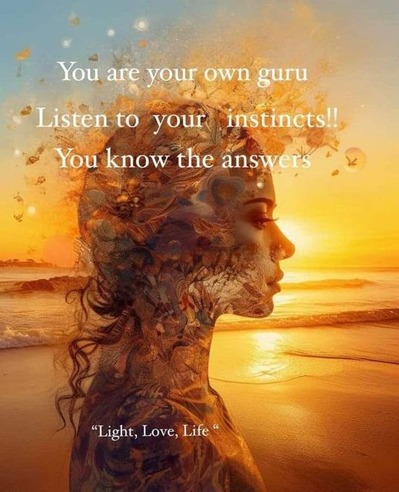

Slide 13
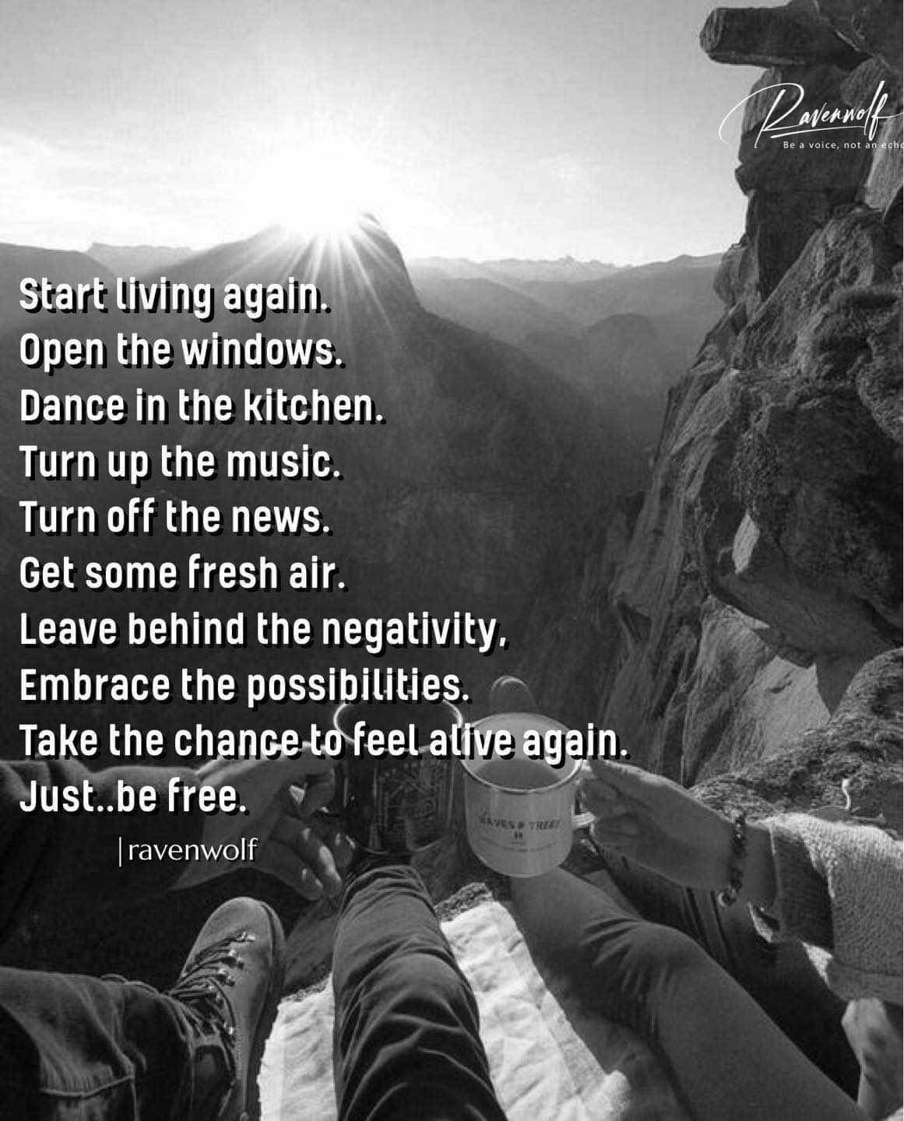

Slide 14
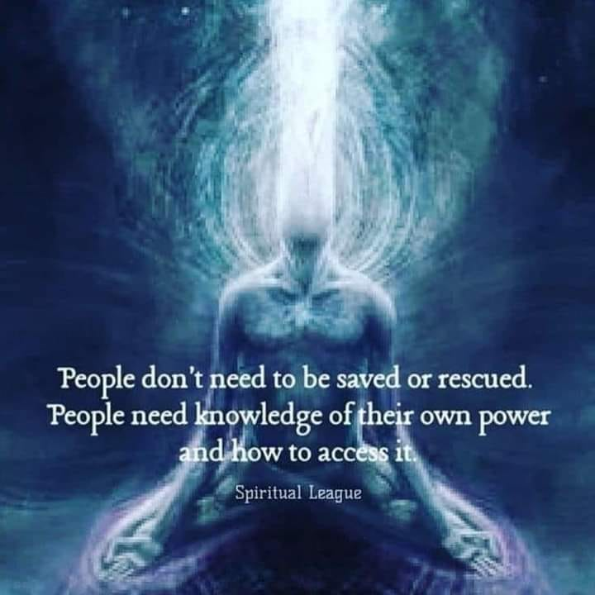

Slide 15
Begin the journey to find your inner treasure......

Slide 16
Hoping this sharing will help you find your hidden treasure
If you have any ?s
or would like some mentoring
please contact me at
david@reikiaccess.com

