Slide 1


Color Me Rainbow: refections of a gay priest
Composed, Adapted & Directed
by David Benzshawel

Slide 2

A gift of my journey to find my authentic self….
I am now in retirement living on the ocean in port Aransas tx with my two rescue dogs….if you would like a “retreat” or “beach getaway” here check out my rental “Beach Bum” available on Air B&B, VRBO or local property management at grandwelcome.com
I have written & shared these short plays over the course of my spiritual journey….from HS to present day it reflects some of the lessons I have learned from my personal experience in learning from the “school o hard knocks”
This is MY journey NOT advice it meant to inspire YOU to discover your own unique spiritual path….as a mentor I am here to assist you at David@reikiaccess.com or my FB Page David Benzshawel

Slide 3
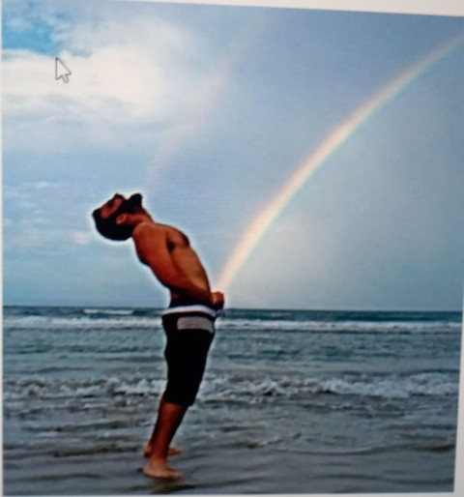
My journey in life has been very colorful with many ups & downs as I tried to “fit in/be normal”. I reached a point that I began awakening to becoming my own authentic person.
It is my hope by sharing these moments in my life that it will encourage others
To keep going & finally become the best person they can be.” (my recorded voice with only slide on screen)

Slide 4

“Because I was in choir & theatre in High School I was labeled & bullied as a FAGGOT/HOMO
I never had any GAY experiences as such until I got away from my Iowa town of 5k to the University of Iowa
It was a very painful time for me in that I was not even sure myself of my own sexual orientation but it seemed others knew before me
I wrote this to try to capture some of these feelings..listen now to the reading of H.S.
(Click on H.S. to view play)

Slide 5
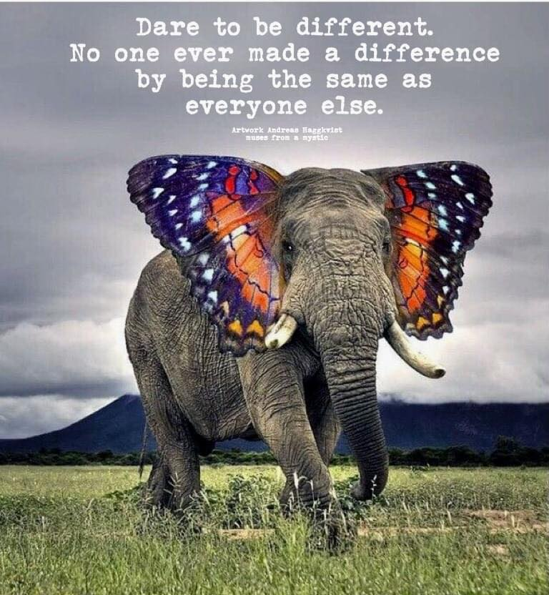
“In Graduate Roman Catholic Seminary
I told my Spiritual Director that I thought I might be Bisexual & was asked to leave….
Did you ever feel abandoned by God?
I felt I was following a calling to serve in the Church…but what happens when you are told you don’t fit in….can you still be “spiritual”? …this piece is adapted from a story found in the book Embracing The Exile by John Fortunato published in 1984… listen now to the reading of God Dilemma: an intimate conversation of three characters “
(Click on this Link God Dilemma )

Slide 6
“43 yrs ago I was ordained an Old Catholic Priest…still trying to fit in
Although I was accepted as a closet gay person in the Old Catholic Church I wanted my relationship to be recognized & be more open as a Gay person in the Church.
Eventually I transferred to UFMCC (Universal Fellowship of Metropolitan Community Churches) and pastored full time 3 churches for them in CA, WA & Tx….listen now to the reading of Welcoming the Stranger.”
(Click on this link to view Welcoming The Stranger )

Slide 7

“Mentoring is still part of being a priest…
After experiencing full time ministry for over 5 yrs I decided I was more called to be a Spiritual Director & received a Licentiate Degree in Spiritual Direction/Spiritual Theology from the Anglican School of Theology in Dallas Tx
I feel more comfortable working one on one or small groups & also discovered Reiki.
I created the website ReikiAccess.com over 25 yrs ago where I teach reiki online on a donation basis to students around the world…listen now to the reading of A Parable of Suffering”
(Click on this link to view Parable of Suffering)

Slide 8

“Relationships come into our lives to teach us a lesson….
I have been in 3 Long Term Relationships for a total of 32 yrs of my life
I chose to leave them when we had either grown apart from our goals, experience abuse, or sexual infidelity
My second relationship lasted 10 yrs until he became mentally unstable due to years of living with AIDS
This play is an attempt to explain his life…listen now to the reading of Hot Child in the City”
(Click on Hot Child In The City to view this play)

Slide 9
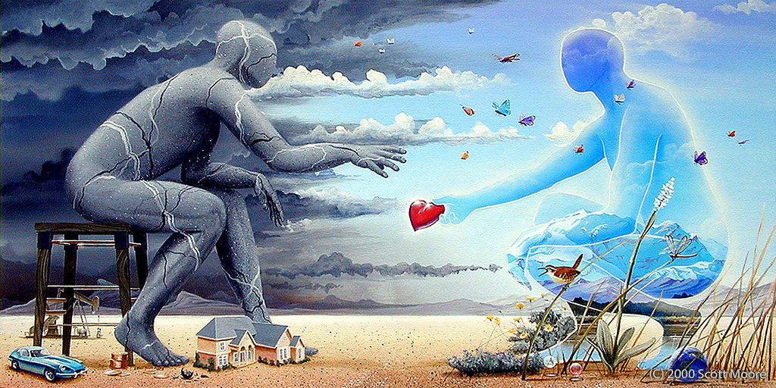
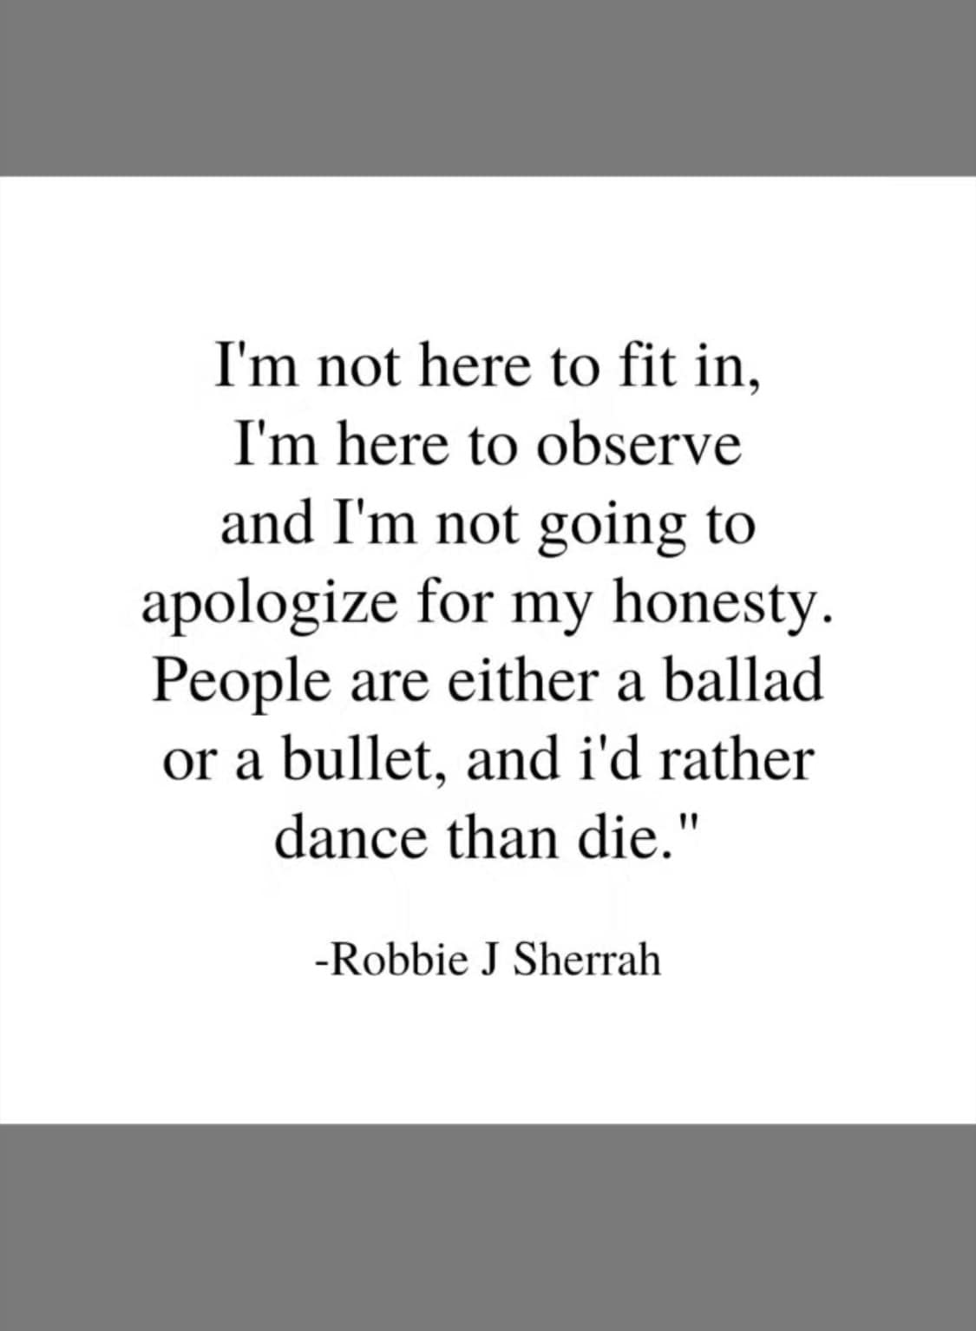
“71 yrs young & still thriving, evolving & growing….
I have had a number of GOOD FRIDAY experiences…but my dad use to always say “you have to roll with the punches!” or “shit happens… are you going to let it bury you under?…. or allow it to fertilize your new growth?”
I was always inspired by the life of St Francis & spent time in college seminary & novitiate with them until I was asked to leave….
This play is adapted from a short book Mr Blue written by Myles Conelly published in 1922 about a modern st francis character living on the streets …now listen to the reading of No Longer Blue”
(Click on the link No Longer Blue to read this play )

Slide 10
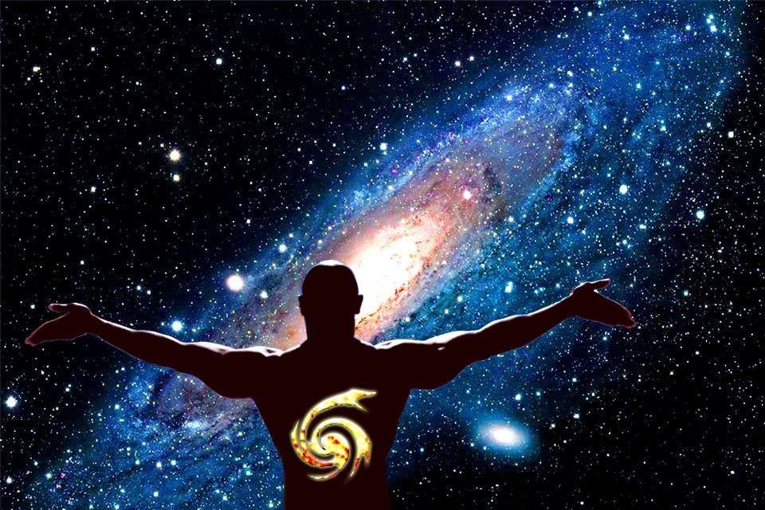
“Don’t throw the baby out with the bath water…
As a Mentor I try to help people discover their connection with spirituality even though they may have been hurt by religion
There is always EASTER hope of resurrection …at least it has for me in my journey…
This last play looks at a different way of thinking about a communion service…now listen to the reading of Coming Into Union”
(Click on the link Coming Into Union to read this play)

Slide 11
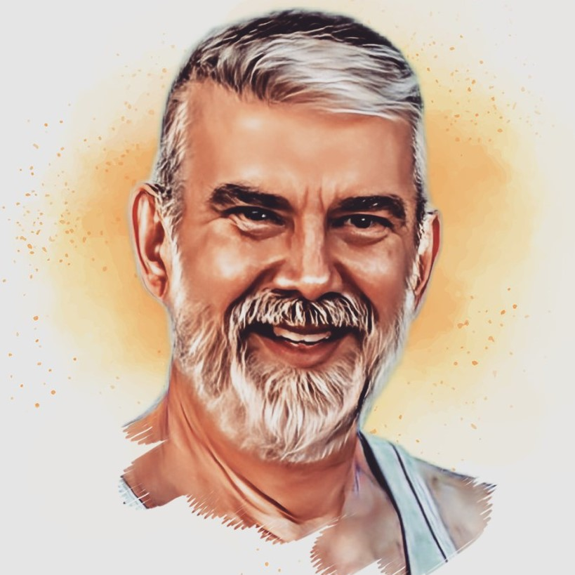

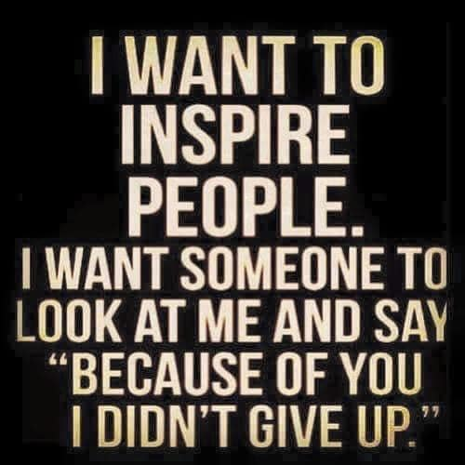
Check out my website reikiaccess.com or my Face Book Pages
David Benzshawel, Spiritual Friends Gathering or A’Ho Gay Mens Spirituality Tribe
…email me at David@reikiaccess.com

