Slide 1
Being Zen
Composed by David Benzshawel send ?s to David@reikiaccess.com

Slide 2
What do you mean?
In this presentation I will be sharing some concepts from my experience that have been helpful on my spiritual journey of 71 yrs...take what resonates within you & try it on for size
What I share is NOT advice or direction but merely inspiration for you to use as YOU see fit....use what resonates with in & feeds your Soul
We are all on unique spiritual paths, but we can share resources, ideas & concepts
Listen to your inner guru/intuition for what might feed your Soul
Love will teach you ...i only seek to mentor by sharing MY experience
The two concepts we will explore is Being & Zen and how they can work together

Slide 3
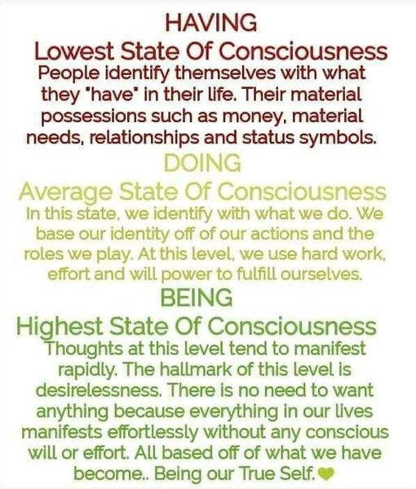
What is Being?

Slide 4
This quote for me was foundational in my understanding of spirituality I was caught up in Doing Things and neglected just Being it was covered up by years of trying to fit in & appear normal I lost the sense of what was my authentic self

Slide 5
Are you Doing or Being?

Slide 6
Is this for you a to DO list or a to BE list?

Slide 7
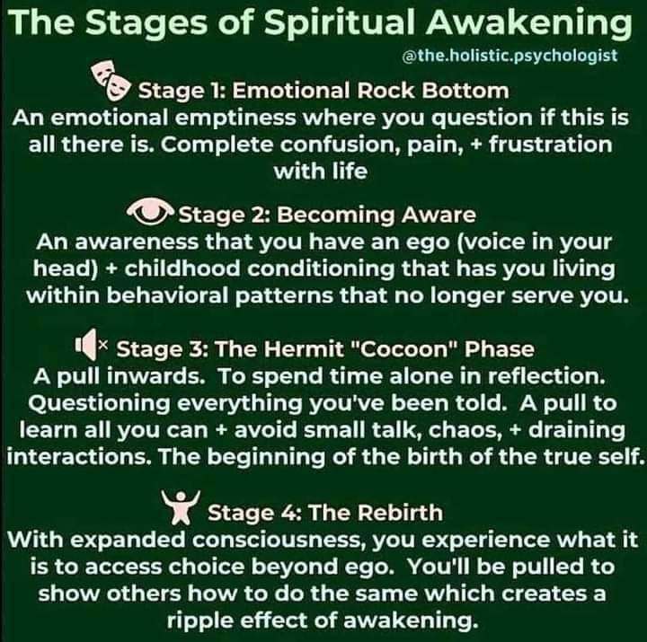
Being may activate a spiritual awakening....
BEING for me comes from the SOUL/subconscious mind/inner Guru/Intuition...many words for the same thing...i follow the concept of SOUL from Carl Jung...

Slide 8
Carl jungs concept of 3 births.....

Slide 9
BEing/spirituality grows into a new reality....

Slide 10
What is Zen?
For me Zen is bare bones buddhism....
stripped of culture, dogma & doctrine to the very basic concepts....
it is like KISS Keep it Simple Stupid!

Slide 11
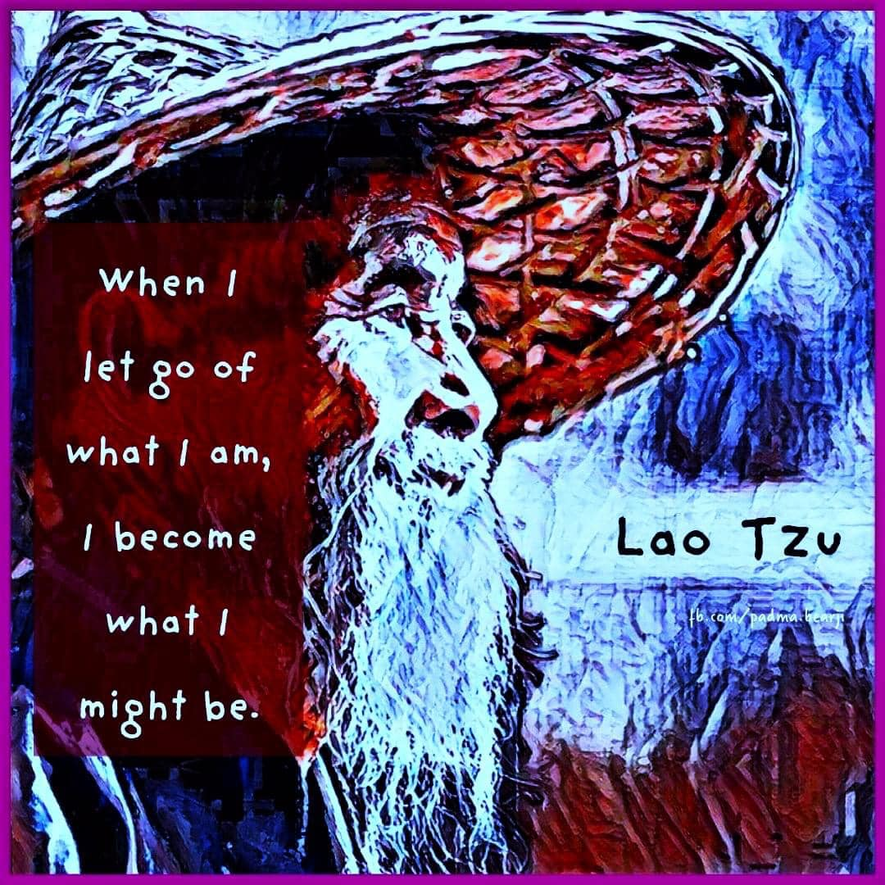

Slide 12
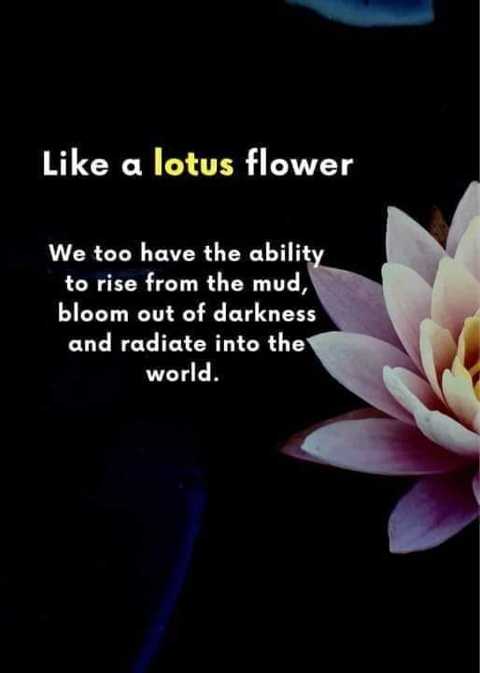

Slide 13
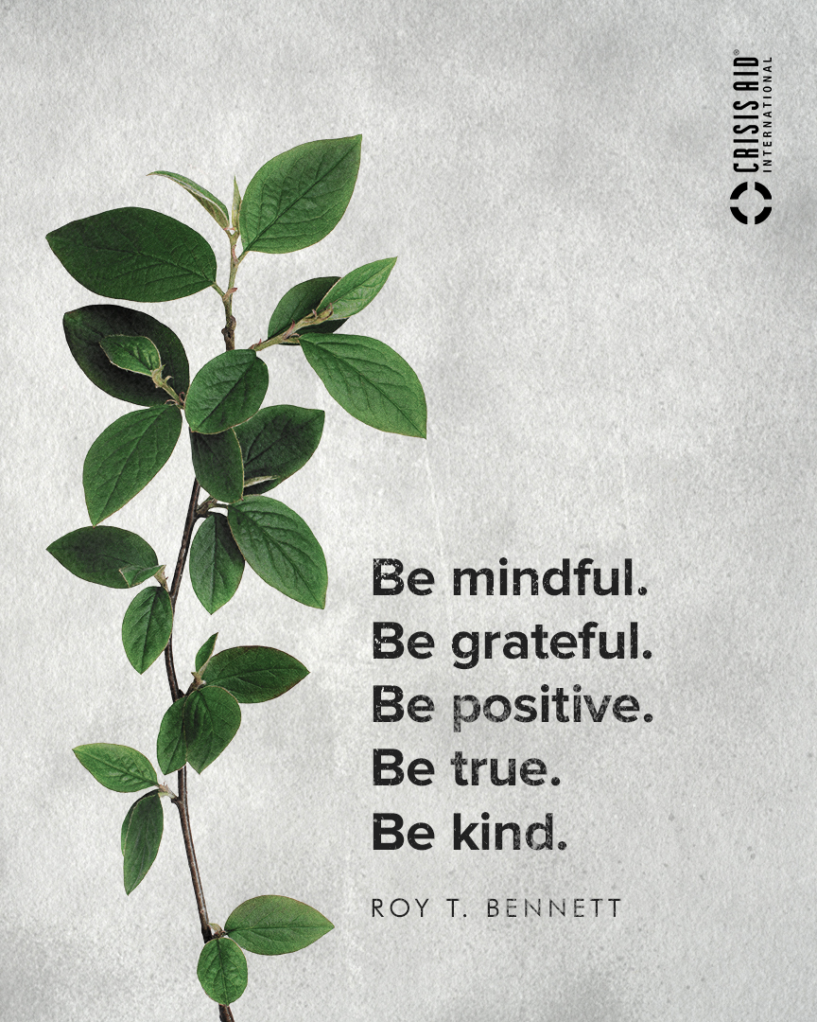

Slide 14
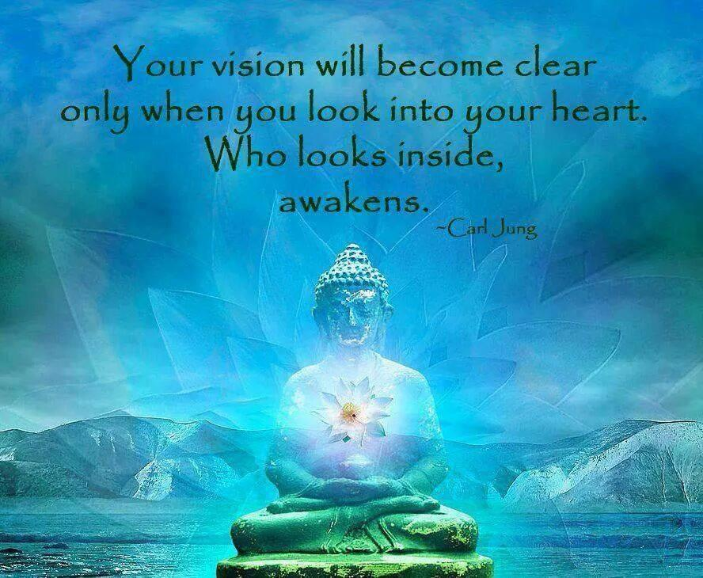

Slide 15
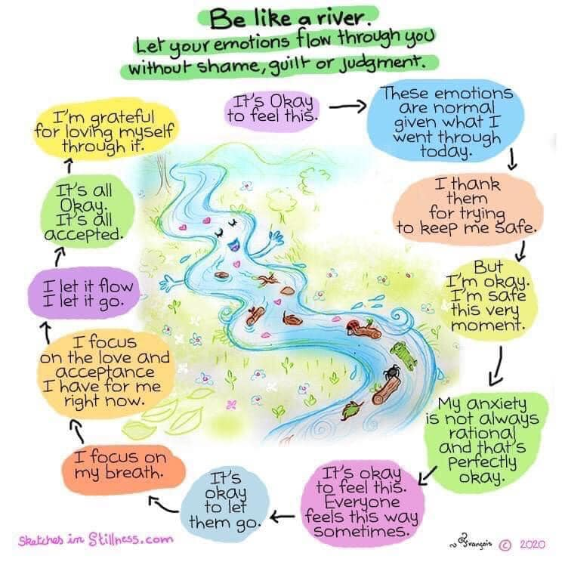
The way I blend being & zen......
Go with the flow of life....
living in the present moment....
trusting the universe to let go of the security of staying near the banks
go into the inner stream to move you where it wills quickly as you ride the current of life.....

Slide 16
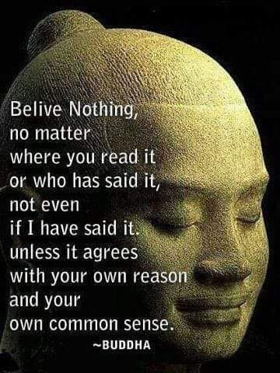

Slide 17
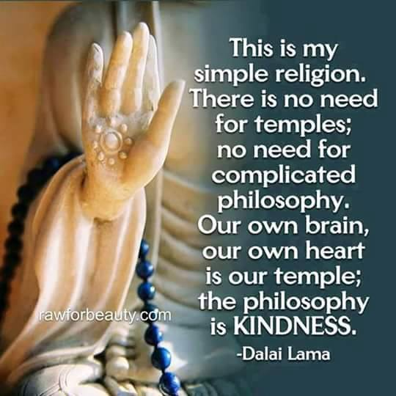

Slide 18
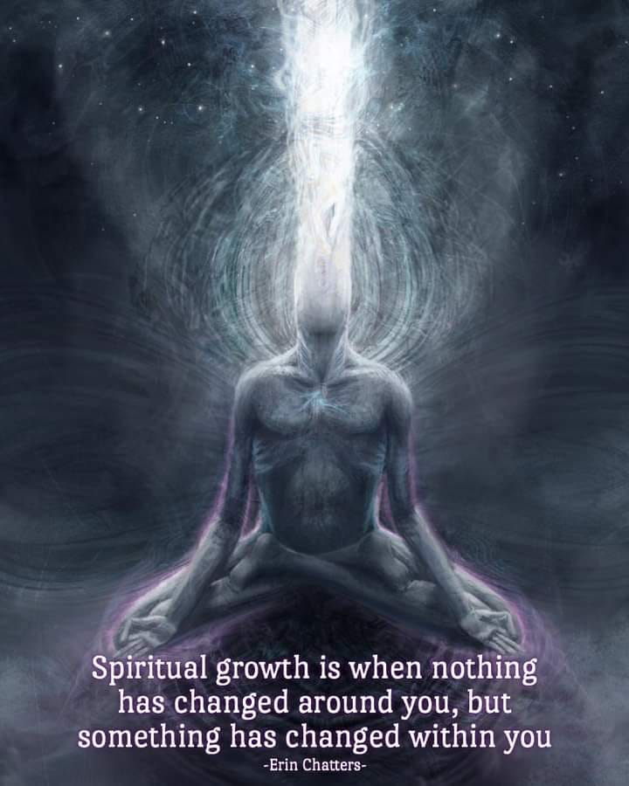

Slide 19
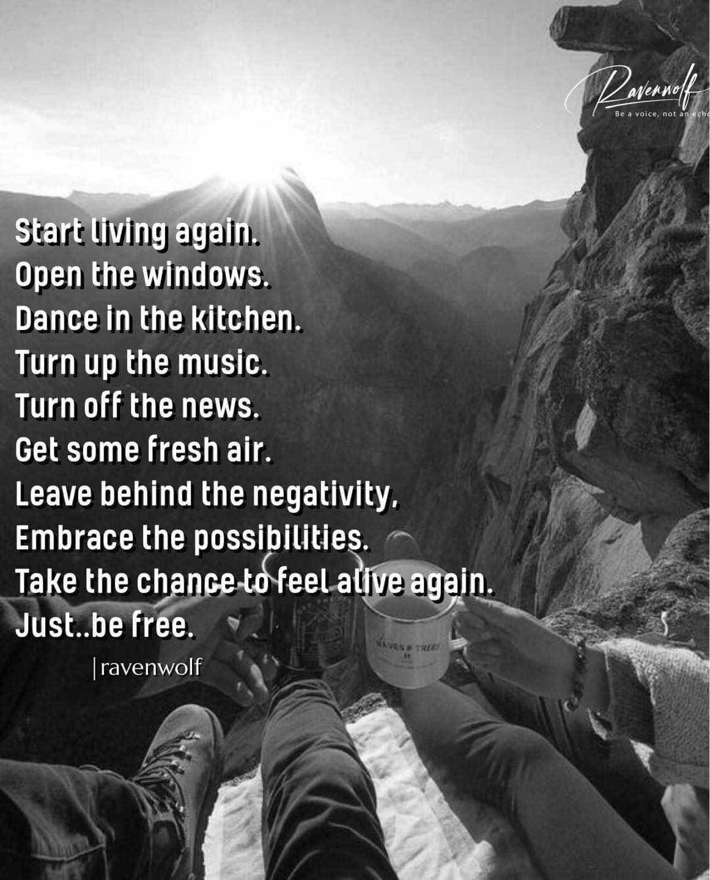

Slide 20
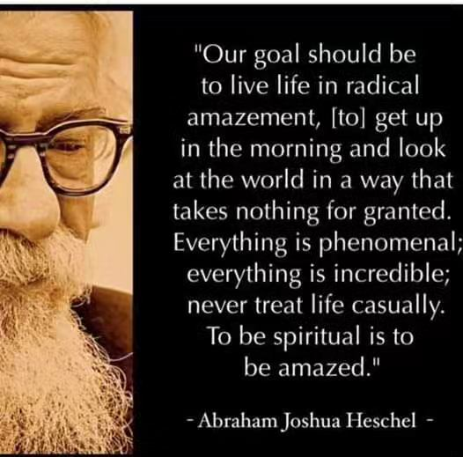

Slide 21
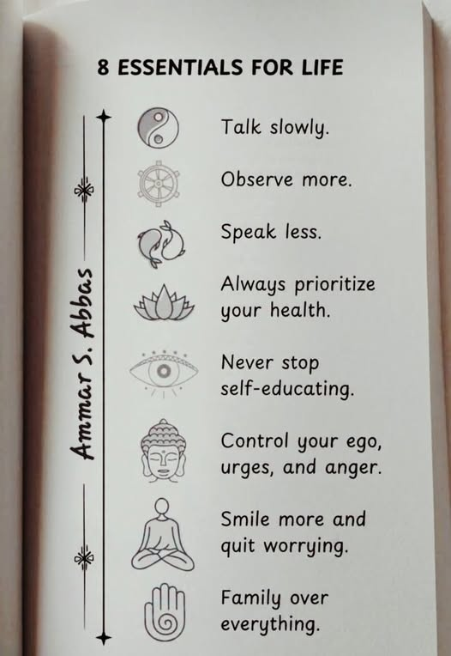

Slide 22
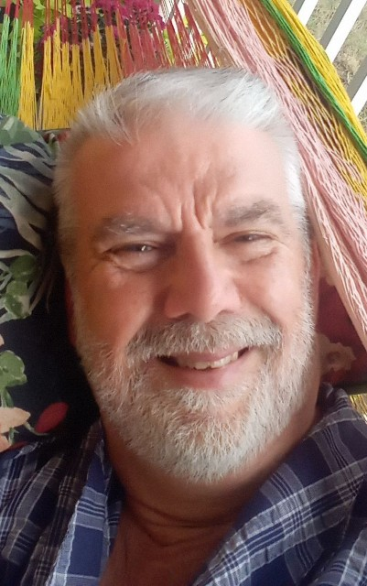
Be the best you can be....find your authentic self.....
It is my hope that this presentation may have inspipred you to try some new approachces in your spiritual journey.....
i have shared from MY experience ….
NOW go out and find your path....
I am here to mentor if needed....email me at david@reikiaccess.com
Namaste you all
David

