Slide 1
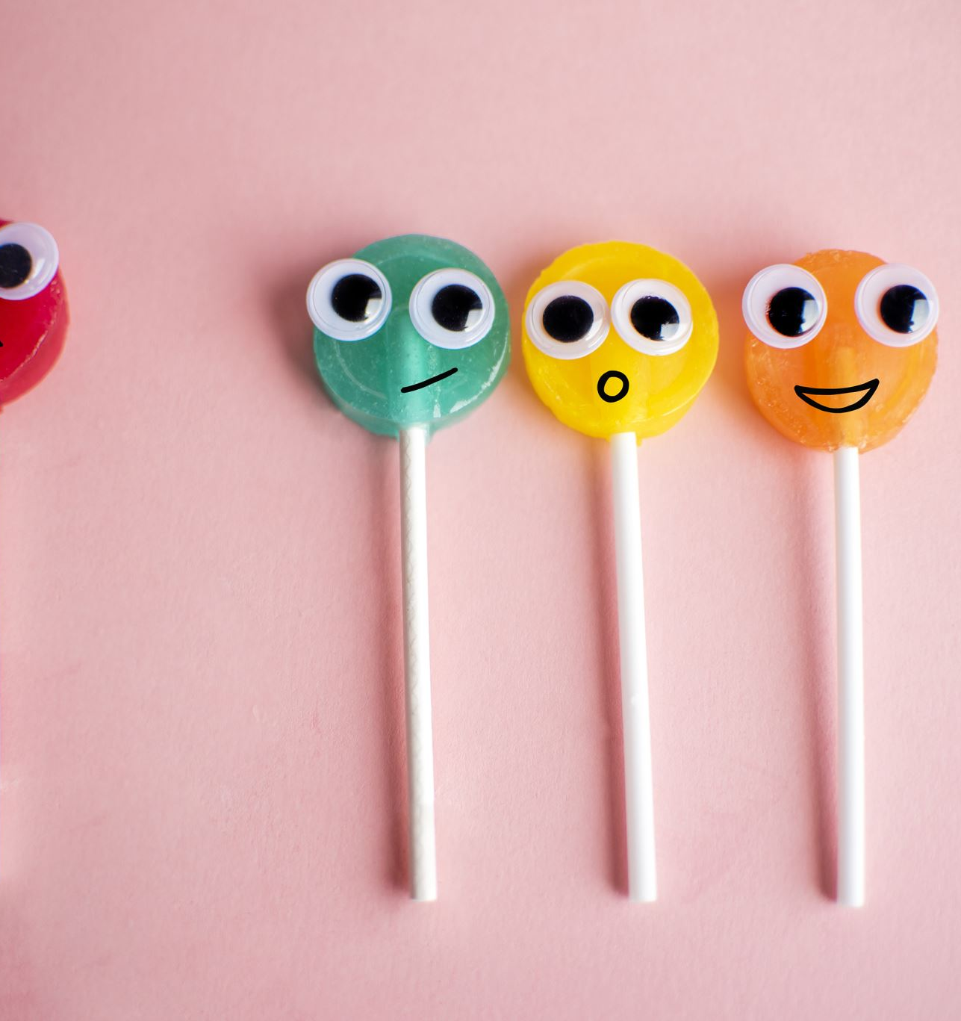
Balancing the Trinity
Composed by David Benzshawel
?s to david@reikiaccess.com

Slide 2
What does the word "Trinity" mean?
In the Christian religion, the Trinity is the most known doctrine about the nature of God in most Christian churches. This idea is used to explain that three distinct divine persons—God the Father, God the Son Jesus Christ, and God the Holy Spirit—are of the same essence (homoousion), share the same qualities, and are therefore One God.
Each person in the Trinity has the same qualities as God because they are each fully God; no other member is less God than the other. Because God is uncreated and has always existed, this also applies to them.
The word "Trinity" comes from the Latin word "Trinitas", meaning "the number three". The corresponding word in Greek is "Τριάς" (Trias), meaning "a set of three" or "the number three". The word trinity is derived from the Platonic term trias meaning three, and is philosophical in origin.

Slide 3
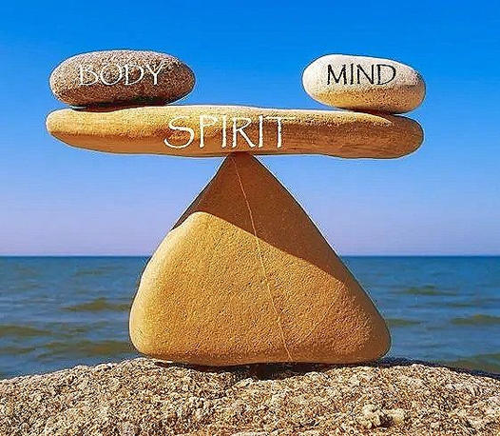
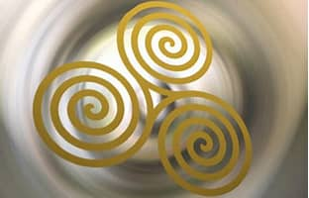
Why balance the concept of Trinity?
For me the Trinity means body, mind & spirit....to find balance in all 3 aspects of me helps me grow & thrive....
The Celtic triple spiral, also known as the triskele, represents balance, harmony, and continual motion. It is found in ancient carvings, such as Newgrange in Ireland, dating back to 2500 BC. The triskele consists of three interconnected spirals or three bent human legs radiating from a center, creating a threefold rotational symmetryic image of trinity & is still used as a healing symbol
We will look at each aspect in ways to find balance in each one

Slide 4
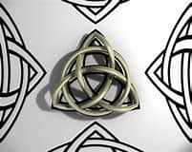
Other Celetic images of the trinity....
The Trinity Knot, also known as the Celtic Trinity Knot or Triquetra, is a mystical Celtic symbol¹²³. It represents the power of three, a sacred number in both Pagan and Christian traditions¹³. The Trinity Knot was believed to represent the three realms of existence - earth, sea, and sky, and was associated with the triple goddess⁵.

Slide 5
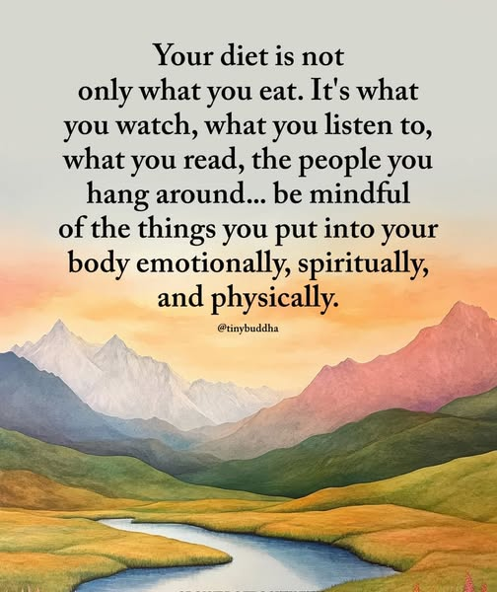
Balancing the Body....
The Body needs to find balance in weight, activity, rest and what we eat to maintain proper weight for our height (Body Mass Index)
I am a certified Dietary Manager check out the presentations on my website reikiaccess.com under the tab "Narrated Powerpoint Presentations" ….topics Healthy Eating Diets No More! & Plant Based Eating & Meal Prep....as well as "Creating your exercise program" for ideas that might resonate with you....also you can look into Chakras which are energy centers in the body to find better balance...

Slide 7
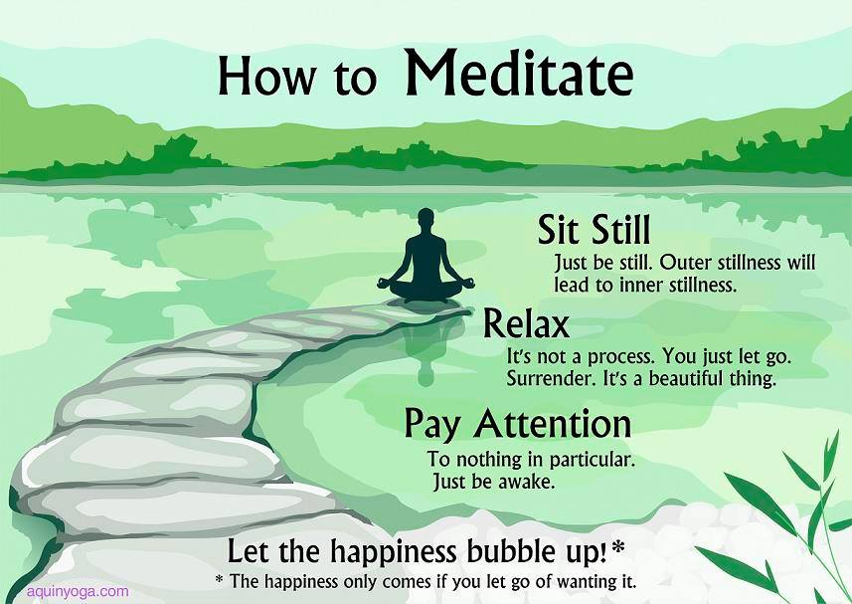
Balancing the Mind....
Buddhism believes we have a "Monkey Mind" that jumps from thought to thought...for me I tame that by mind training of Meditation...if this is new to you check out on Netflix the series "Guide to Meditation"...also it helps to re-wire negative self talk with more positive affirmations for growth

Slide 8
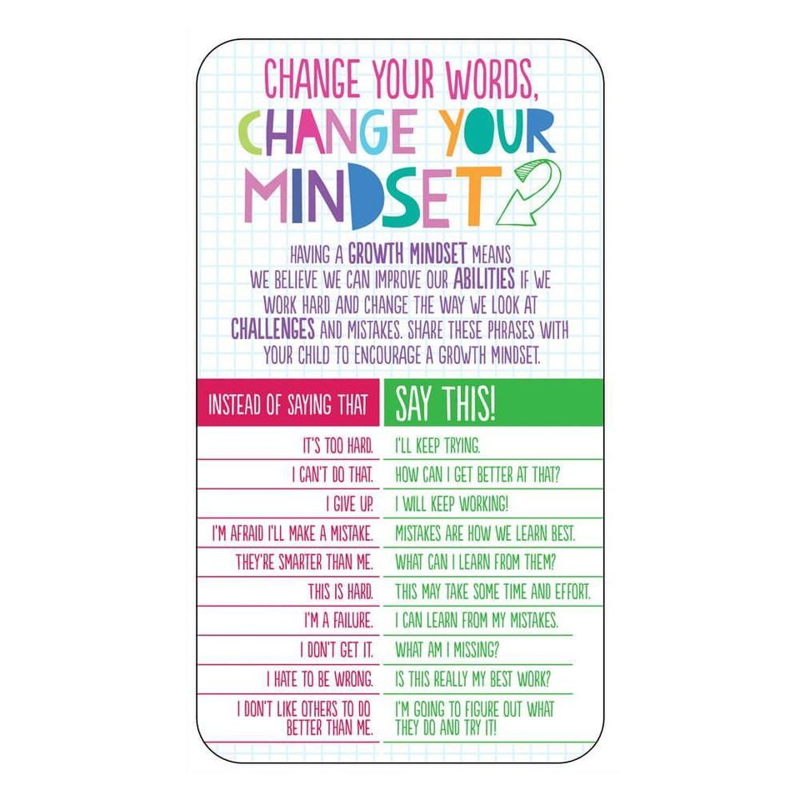
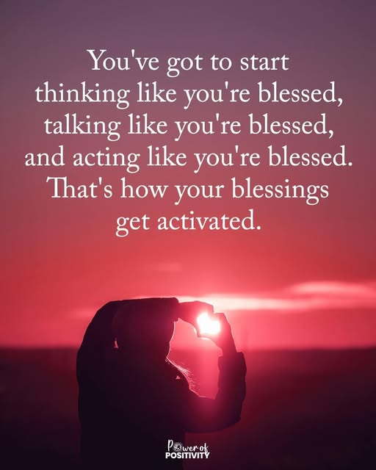

Slide 9
Balancing the Spirit....
For me the first step to balance the spirit is find an aunthentic image of Source that feeds your Spirit....maybe NOT a male father figure keeping tabs on your wrong doings but a more nuturing image...maybe earth mother....the sunrise...for me it is the ocean....nature can be a more inviting image of Source.
Try to remember a moment when you FELT being in the presence of Source....maybe that can be your new image of Source that can feed you spirit?

Slide 10
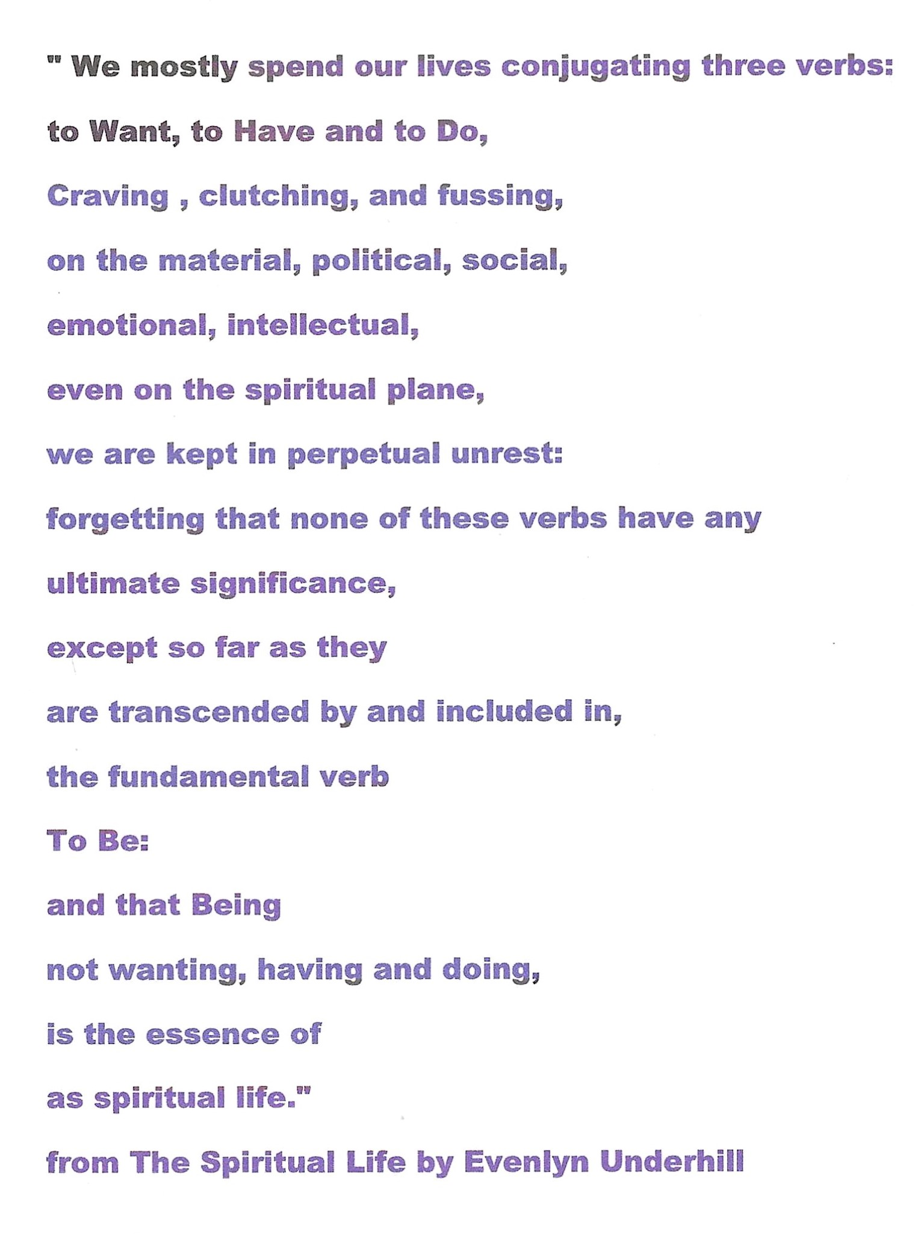
Move from Doing to BEING.....

Slide 11
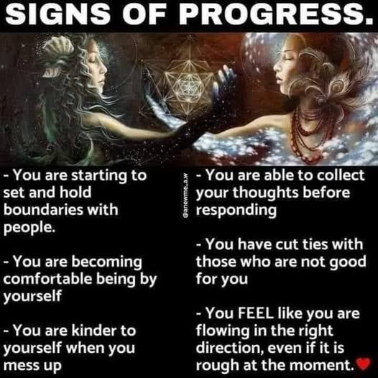

Slide 12
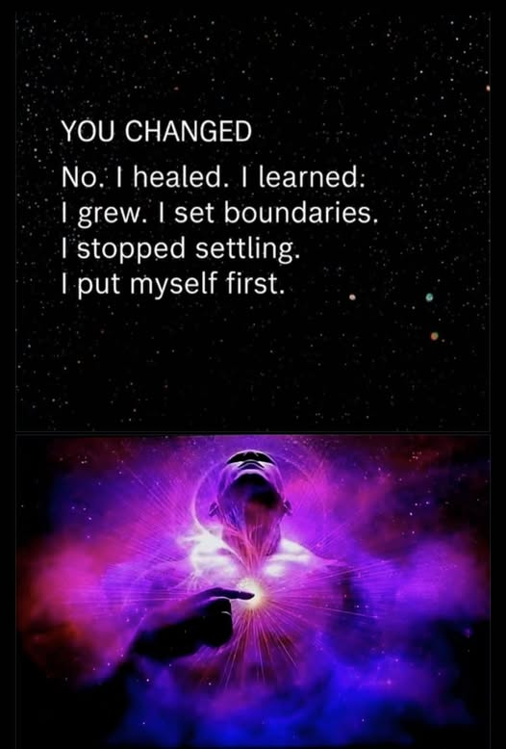

Slide 13
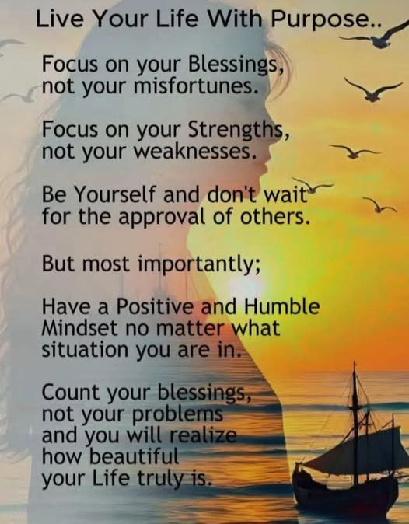

Slide 14
Find some balance....
It is my hope that these ideas will inspire you to try to find balance more in your life....try a few on for size if they resonate within you
I am here if you need mentoring....email me at david@reikiaccess.com or on FaceBook at David Benzshawel or Spiritual Friends Gathering or my website reikiaccess.com under tab Narrate Powerpoint Presentations there are lots of topics to explore & inspire
Namaste you all
David

